Slide 1
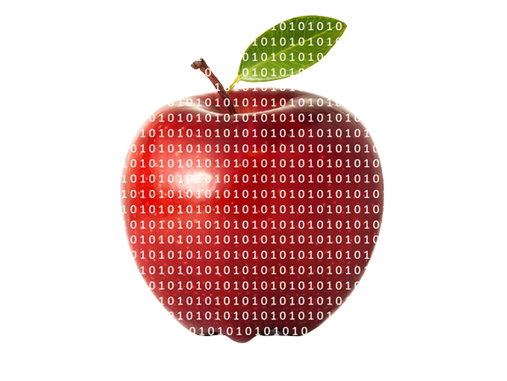


Computational Gastronomy
Centre for
Artificial Intelligence
GANESH BAGLER
Making Food Computable
Notes:
Ganesh Bagler. Making Food Computable. Infosys Centre for Artificial Intelligence.

Slide 2
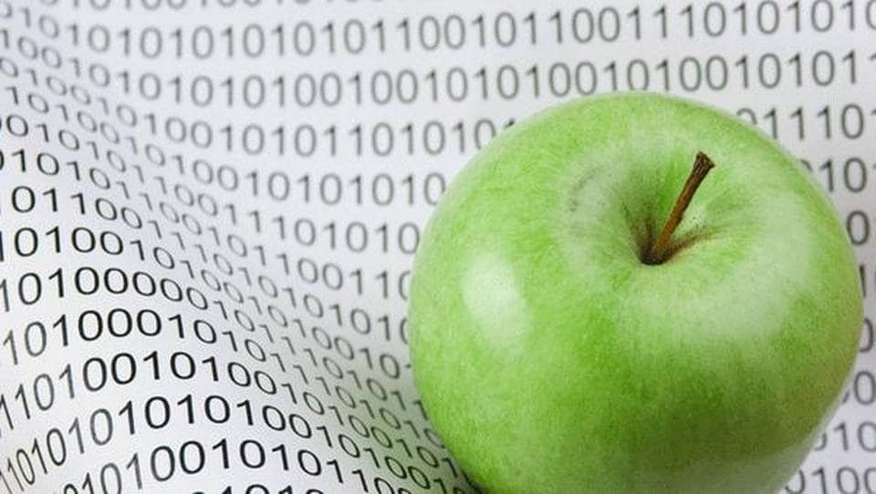
Computational Gastronomy
Making Food Computable
Notes:
Computational Gastronomy: A Data Science = Food + Artificial Intelligence

Slide 3
Computational Gastronomy = Food + AI
Notes:
Computational Gastronomy: A Data Science = Food + Artificial Intelligence

Slide 4
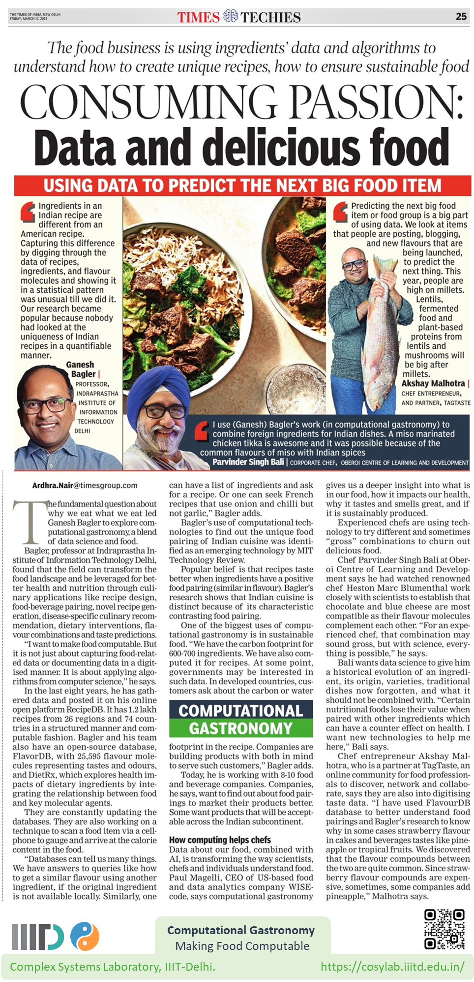

Notes:
Computational gastronomy arrives. The new data science of cooking.
Ai. Not for replacing a food expert. A chef. Or a food technologist. But for enabling them. An Co-Pilot for food experts.

Slide 5

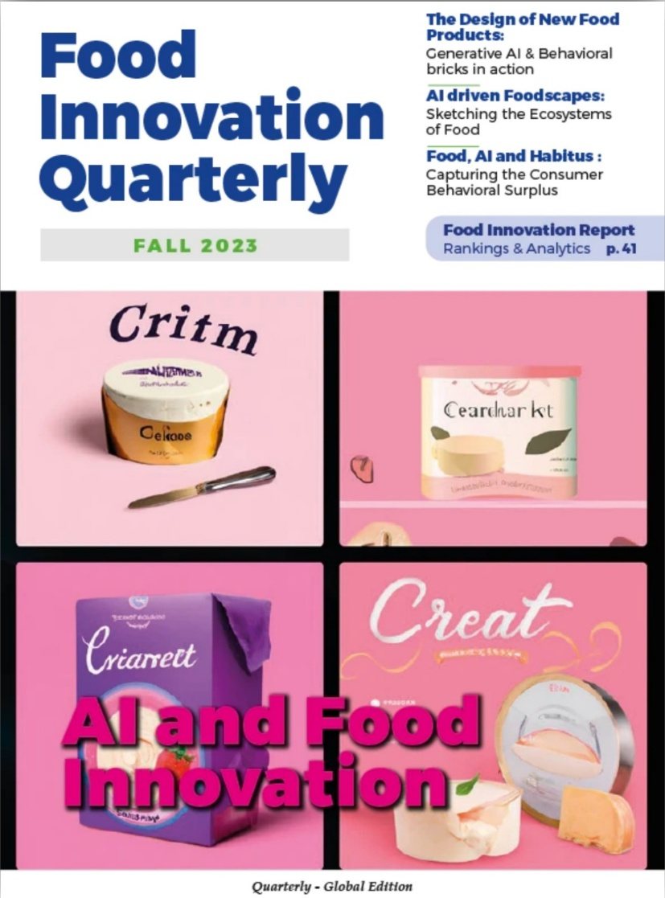
AI and Food Innovations | Paris
A New Data Science of Food
Notes:
Small-town boy. Science Reporter Cover Page.

Slide 6
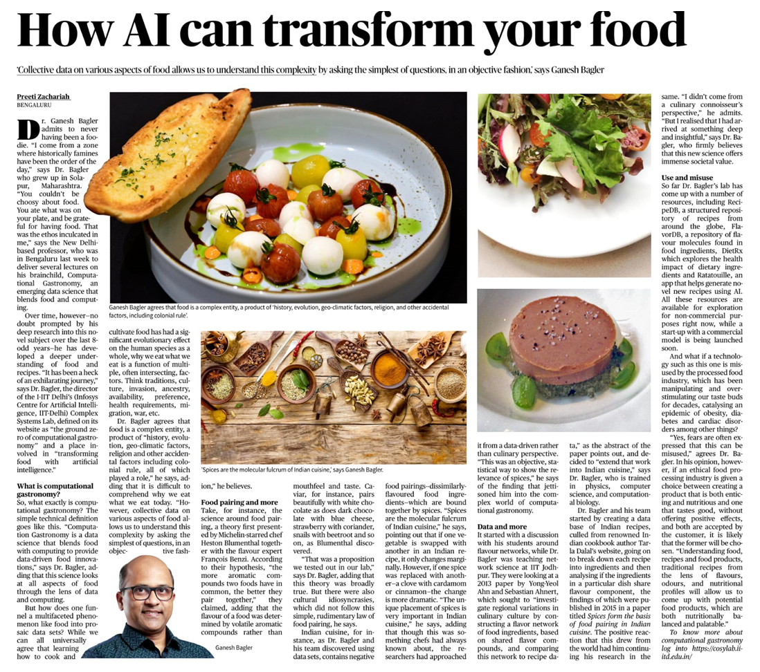

The Hindu (26 September 2023)

Slide 7
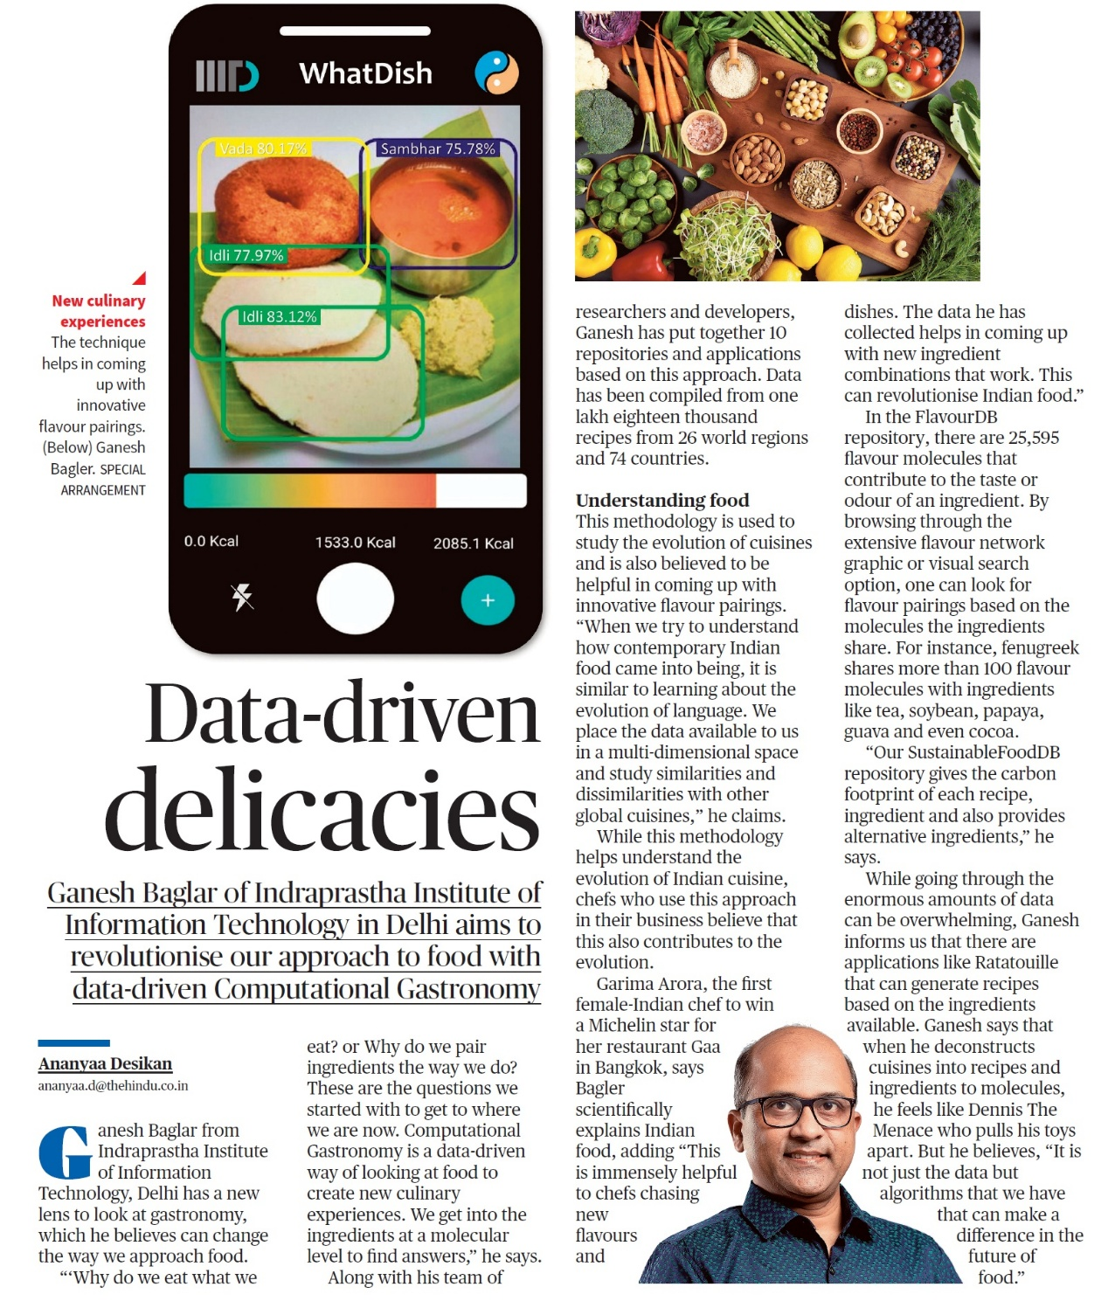
The Hindu (26 October 2023)

Slide 8
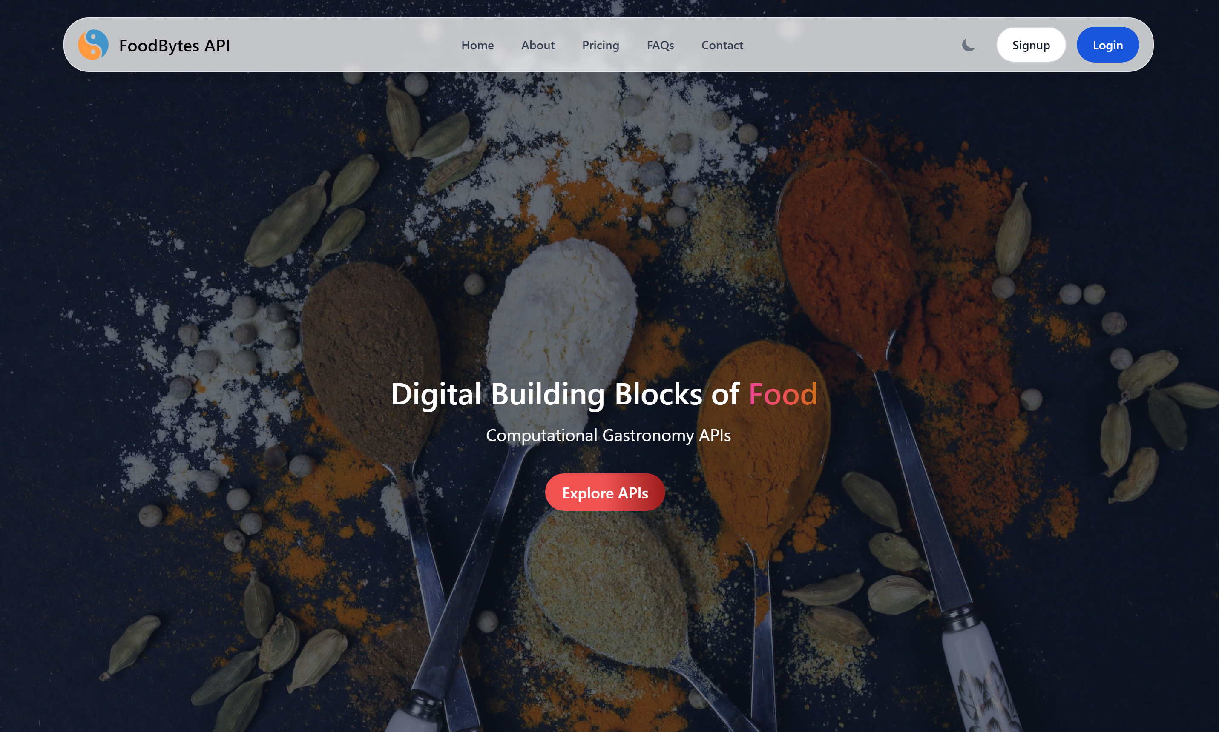
FoodBytes Technologies Private Limited

Slide 9

Recipes
Flavors
Sustainability
Nutrition
Health
Notes:
From Farm To Fork. Data Compilation, Curation, Analysis, Prediction.

Slide 10
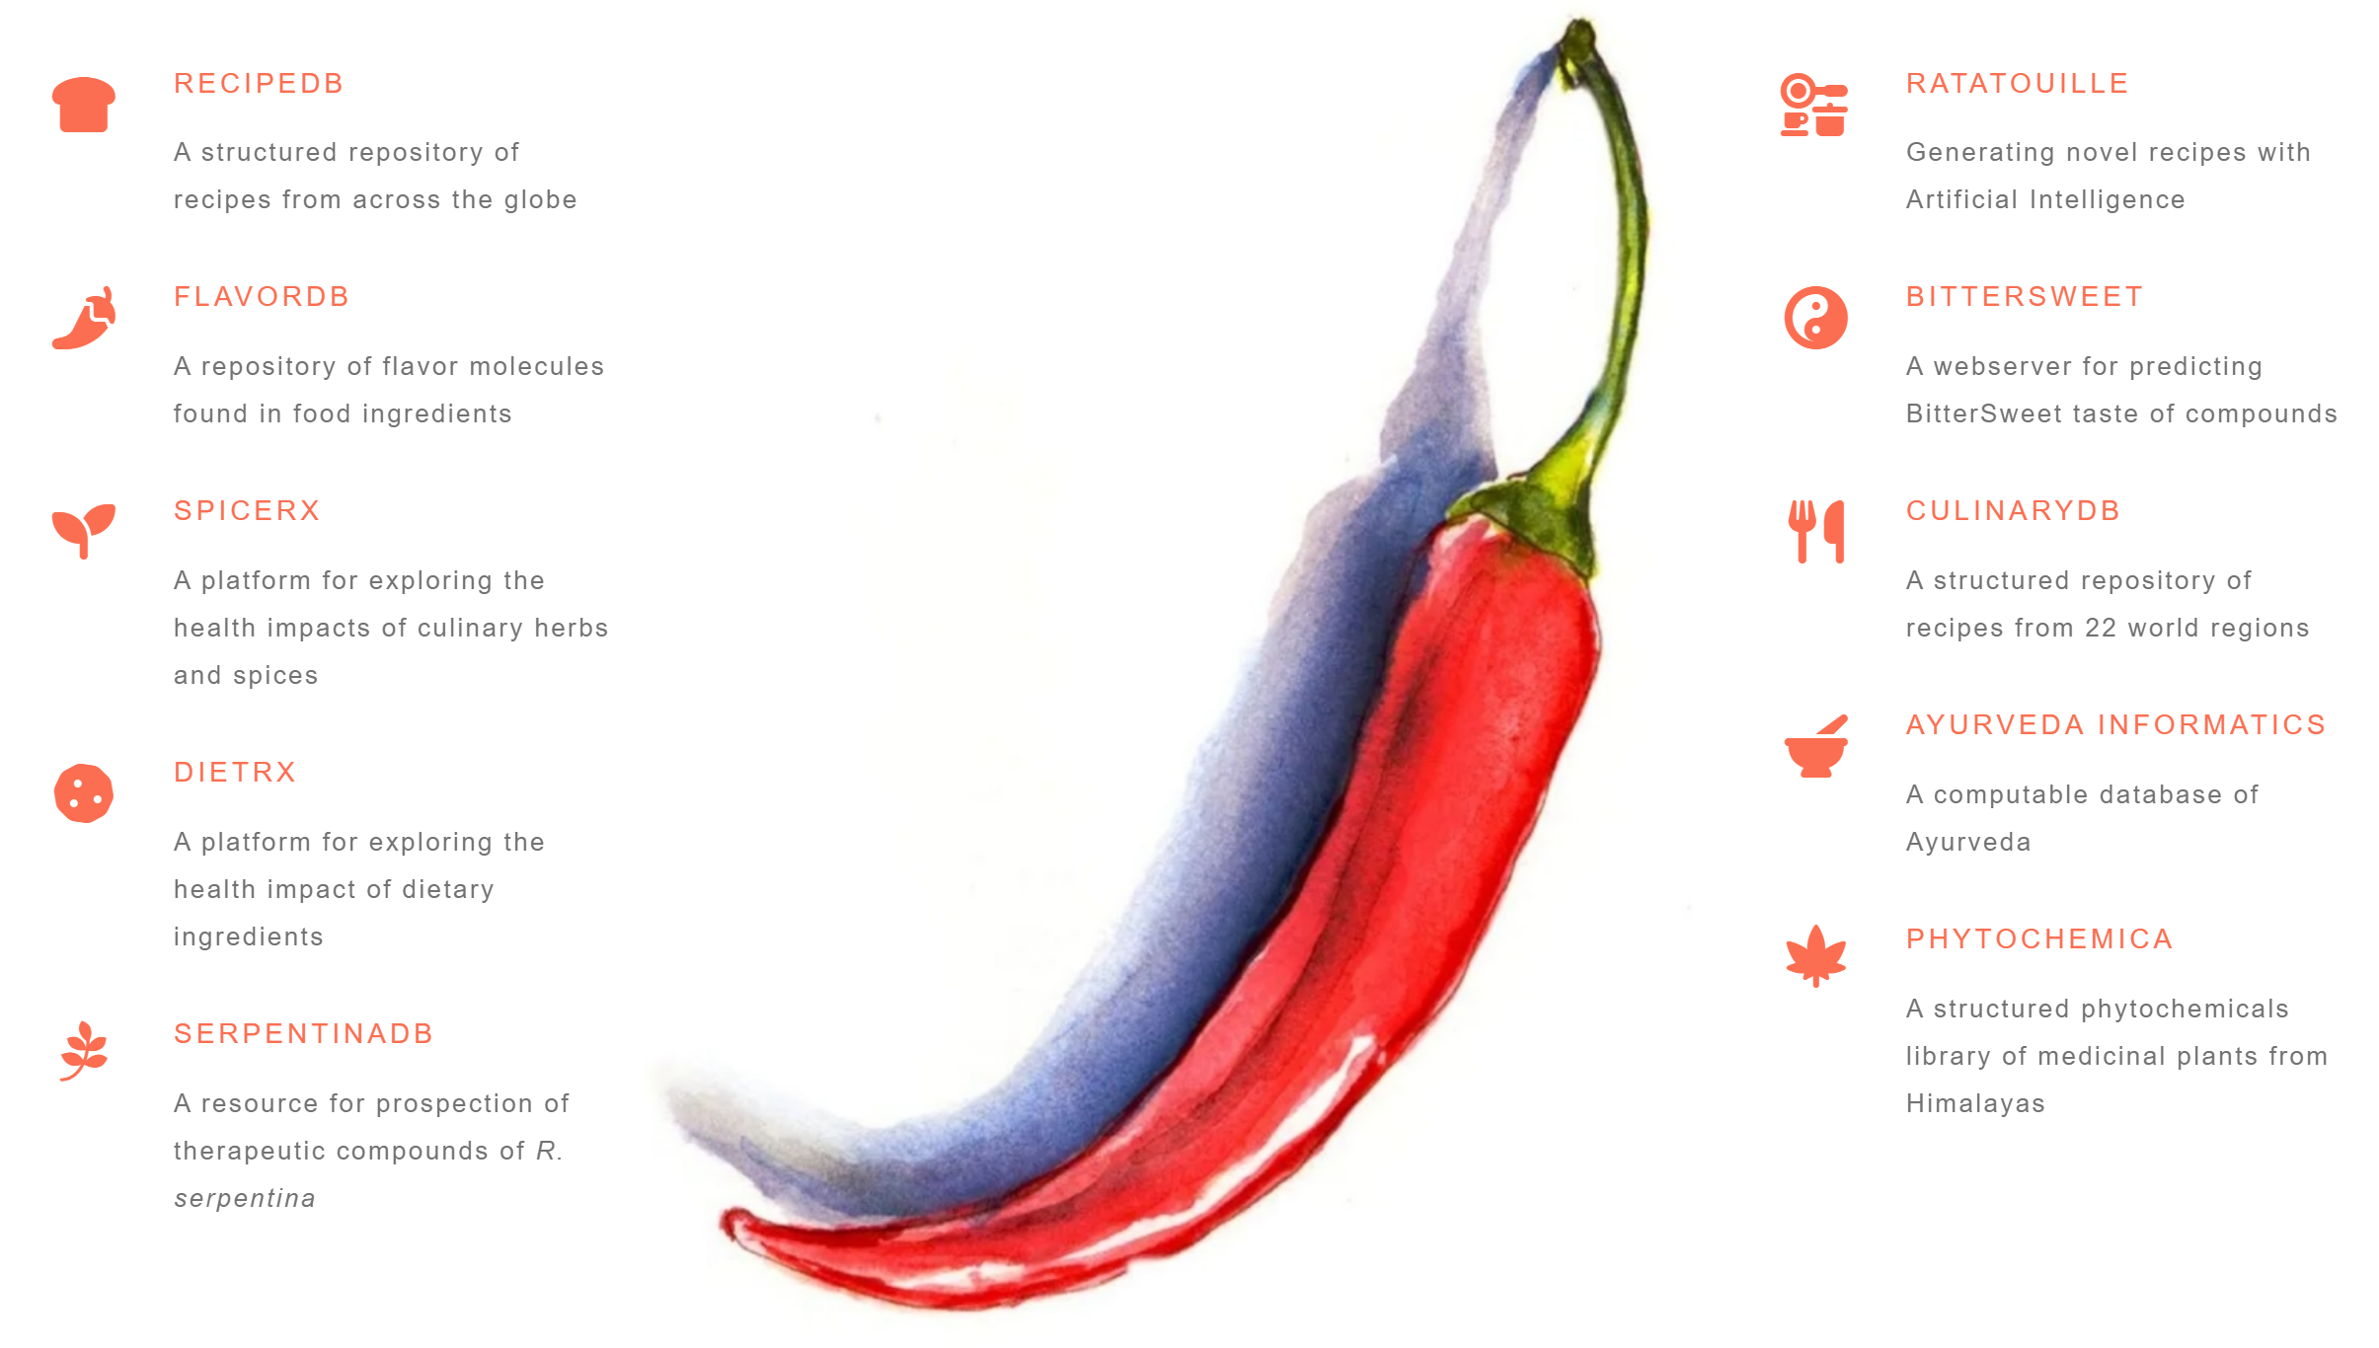
Making Food Computable
Ratatouille
Generate novel recipes with
Artificial Intelligence
RecipeDB
BitterSweet
A structured repository of
Recipes from across the globe
A webserver for predicting
BitterSweet taste molecules
FlavorDB
SweetPred
A repository of flavor molecules
found in food ingredients
State of the art ML algorithms to predict sweetness
SpiceRx
WhatDish
A platform for exploring the
health impacts of culinary herbs
and spices
A real-time dish detection
app for diet management
DietRx
Ayurveda Informatics
A platform for exploring the
health impacts of dietary
ingredients
A computable database of
Ayurveda
SustainableFoodDB
A repository of carbon footprints of recipes
Notes:
Complex Systems Laboratory. Making Food Computable! Data, Algorithms, Tools and more.

Slide 11
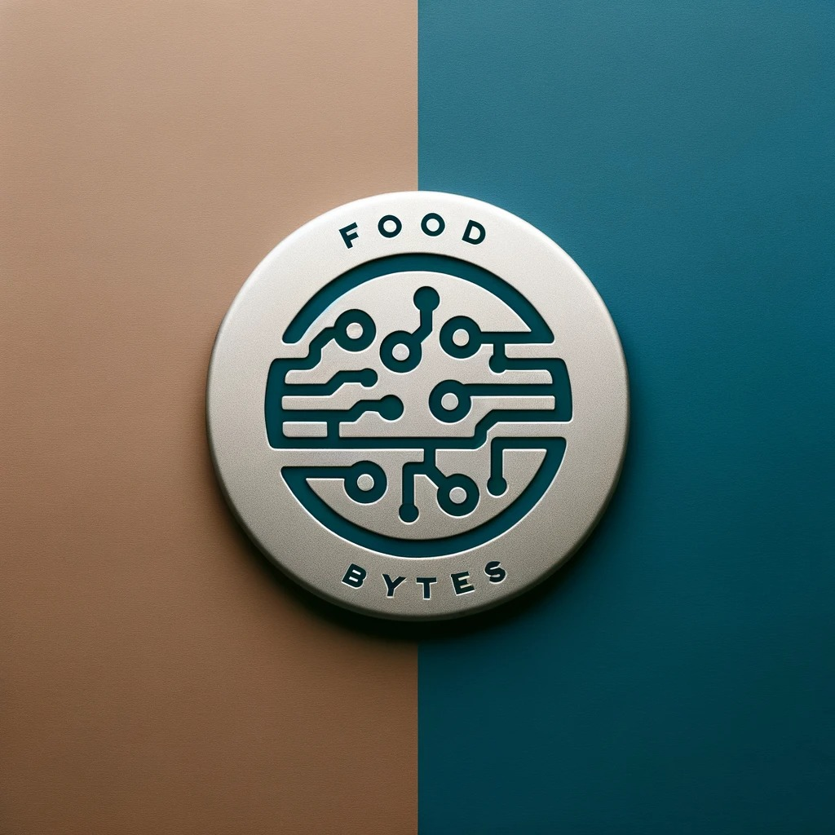

Slide 12
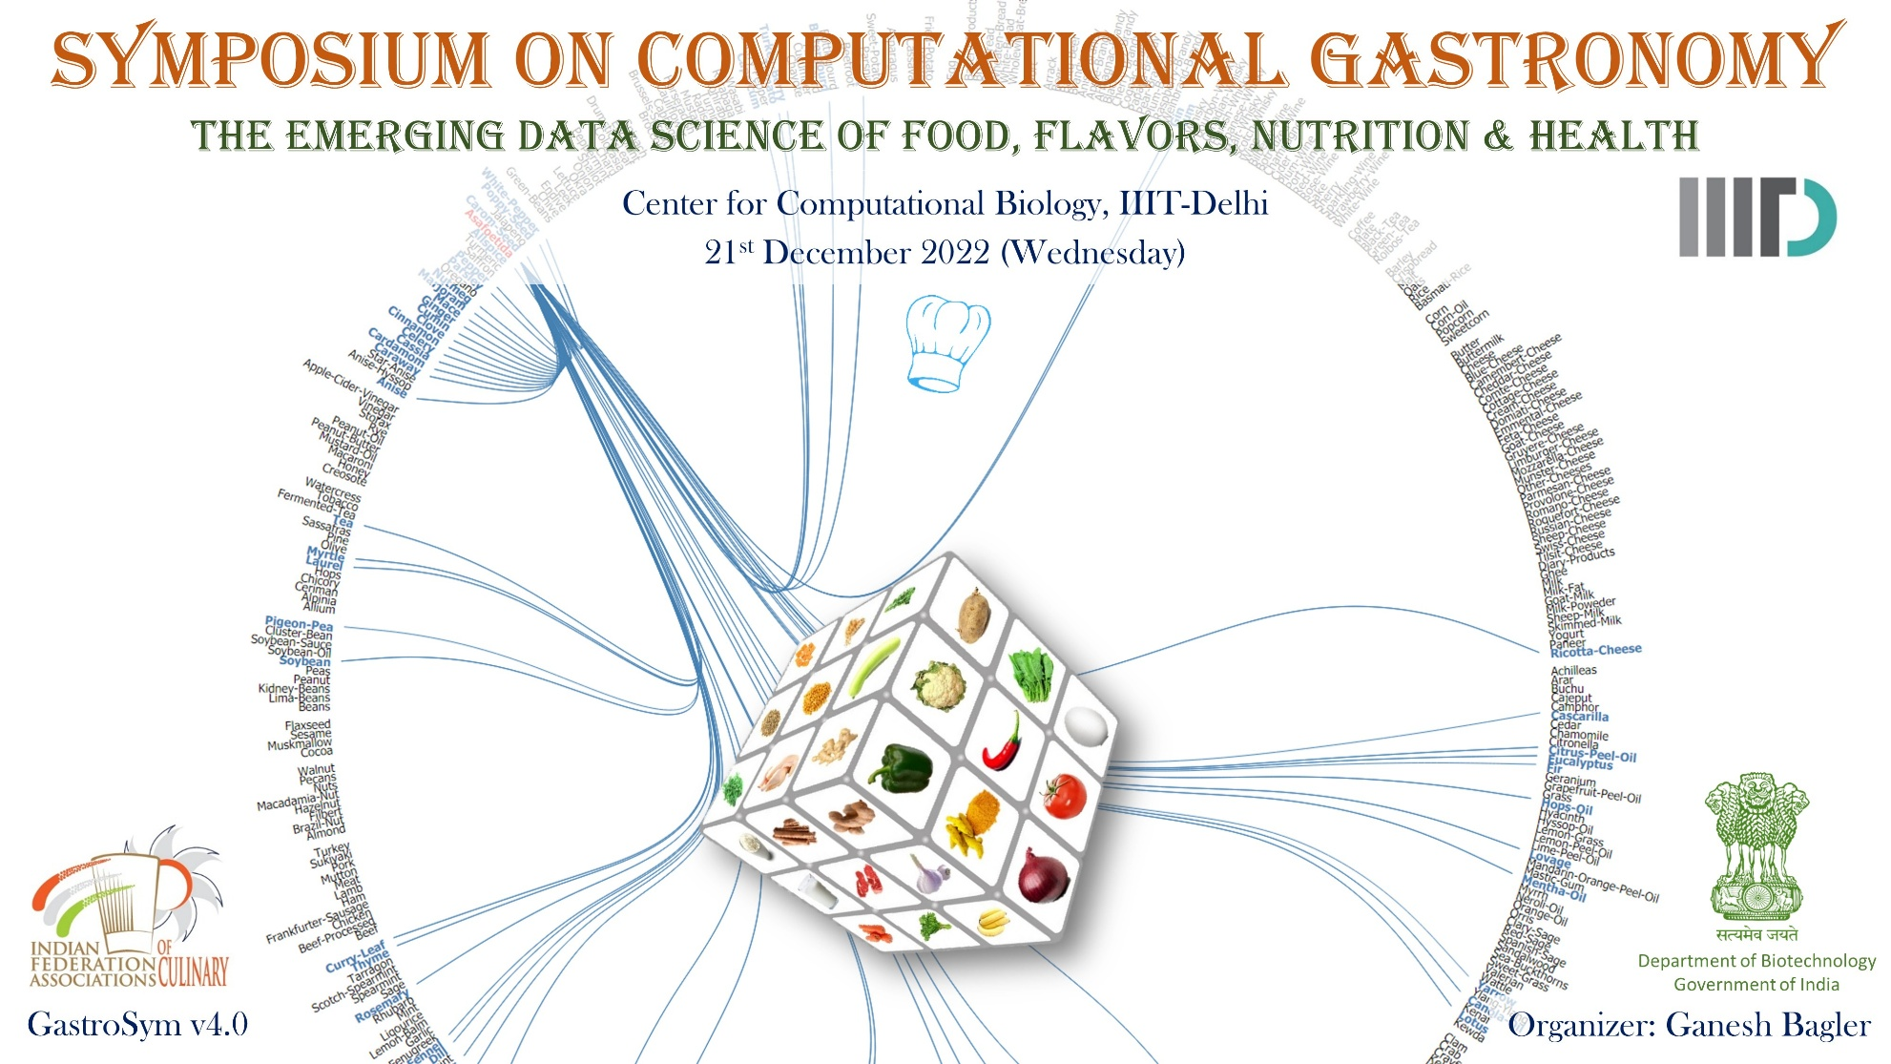
10th December 2023 (Sunday), IIIT-Delhi
10th December 2023 (Sunday), IIIT-Delhi
Notes:
Symposium on Computational Gastronomy

Slide 13
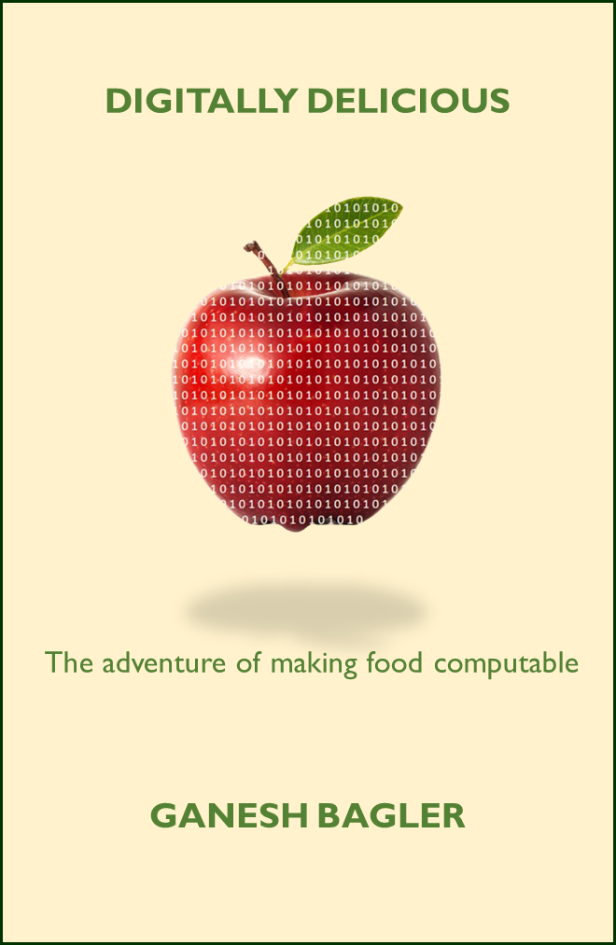
Popular Science Book
Notes:
Science communication. The adventurous story of computational gastronomy.

Slide 14
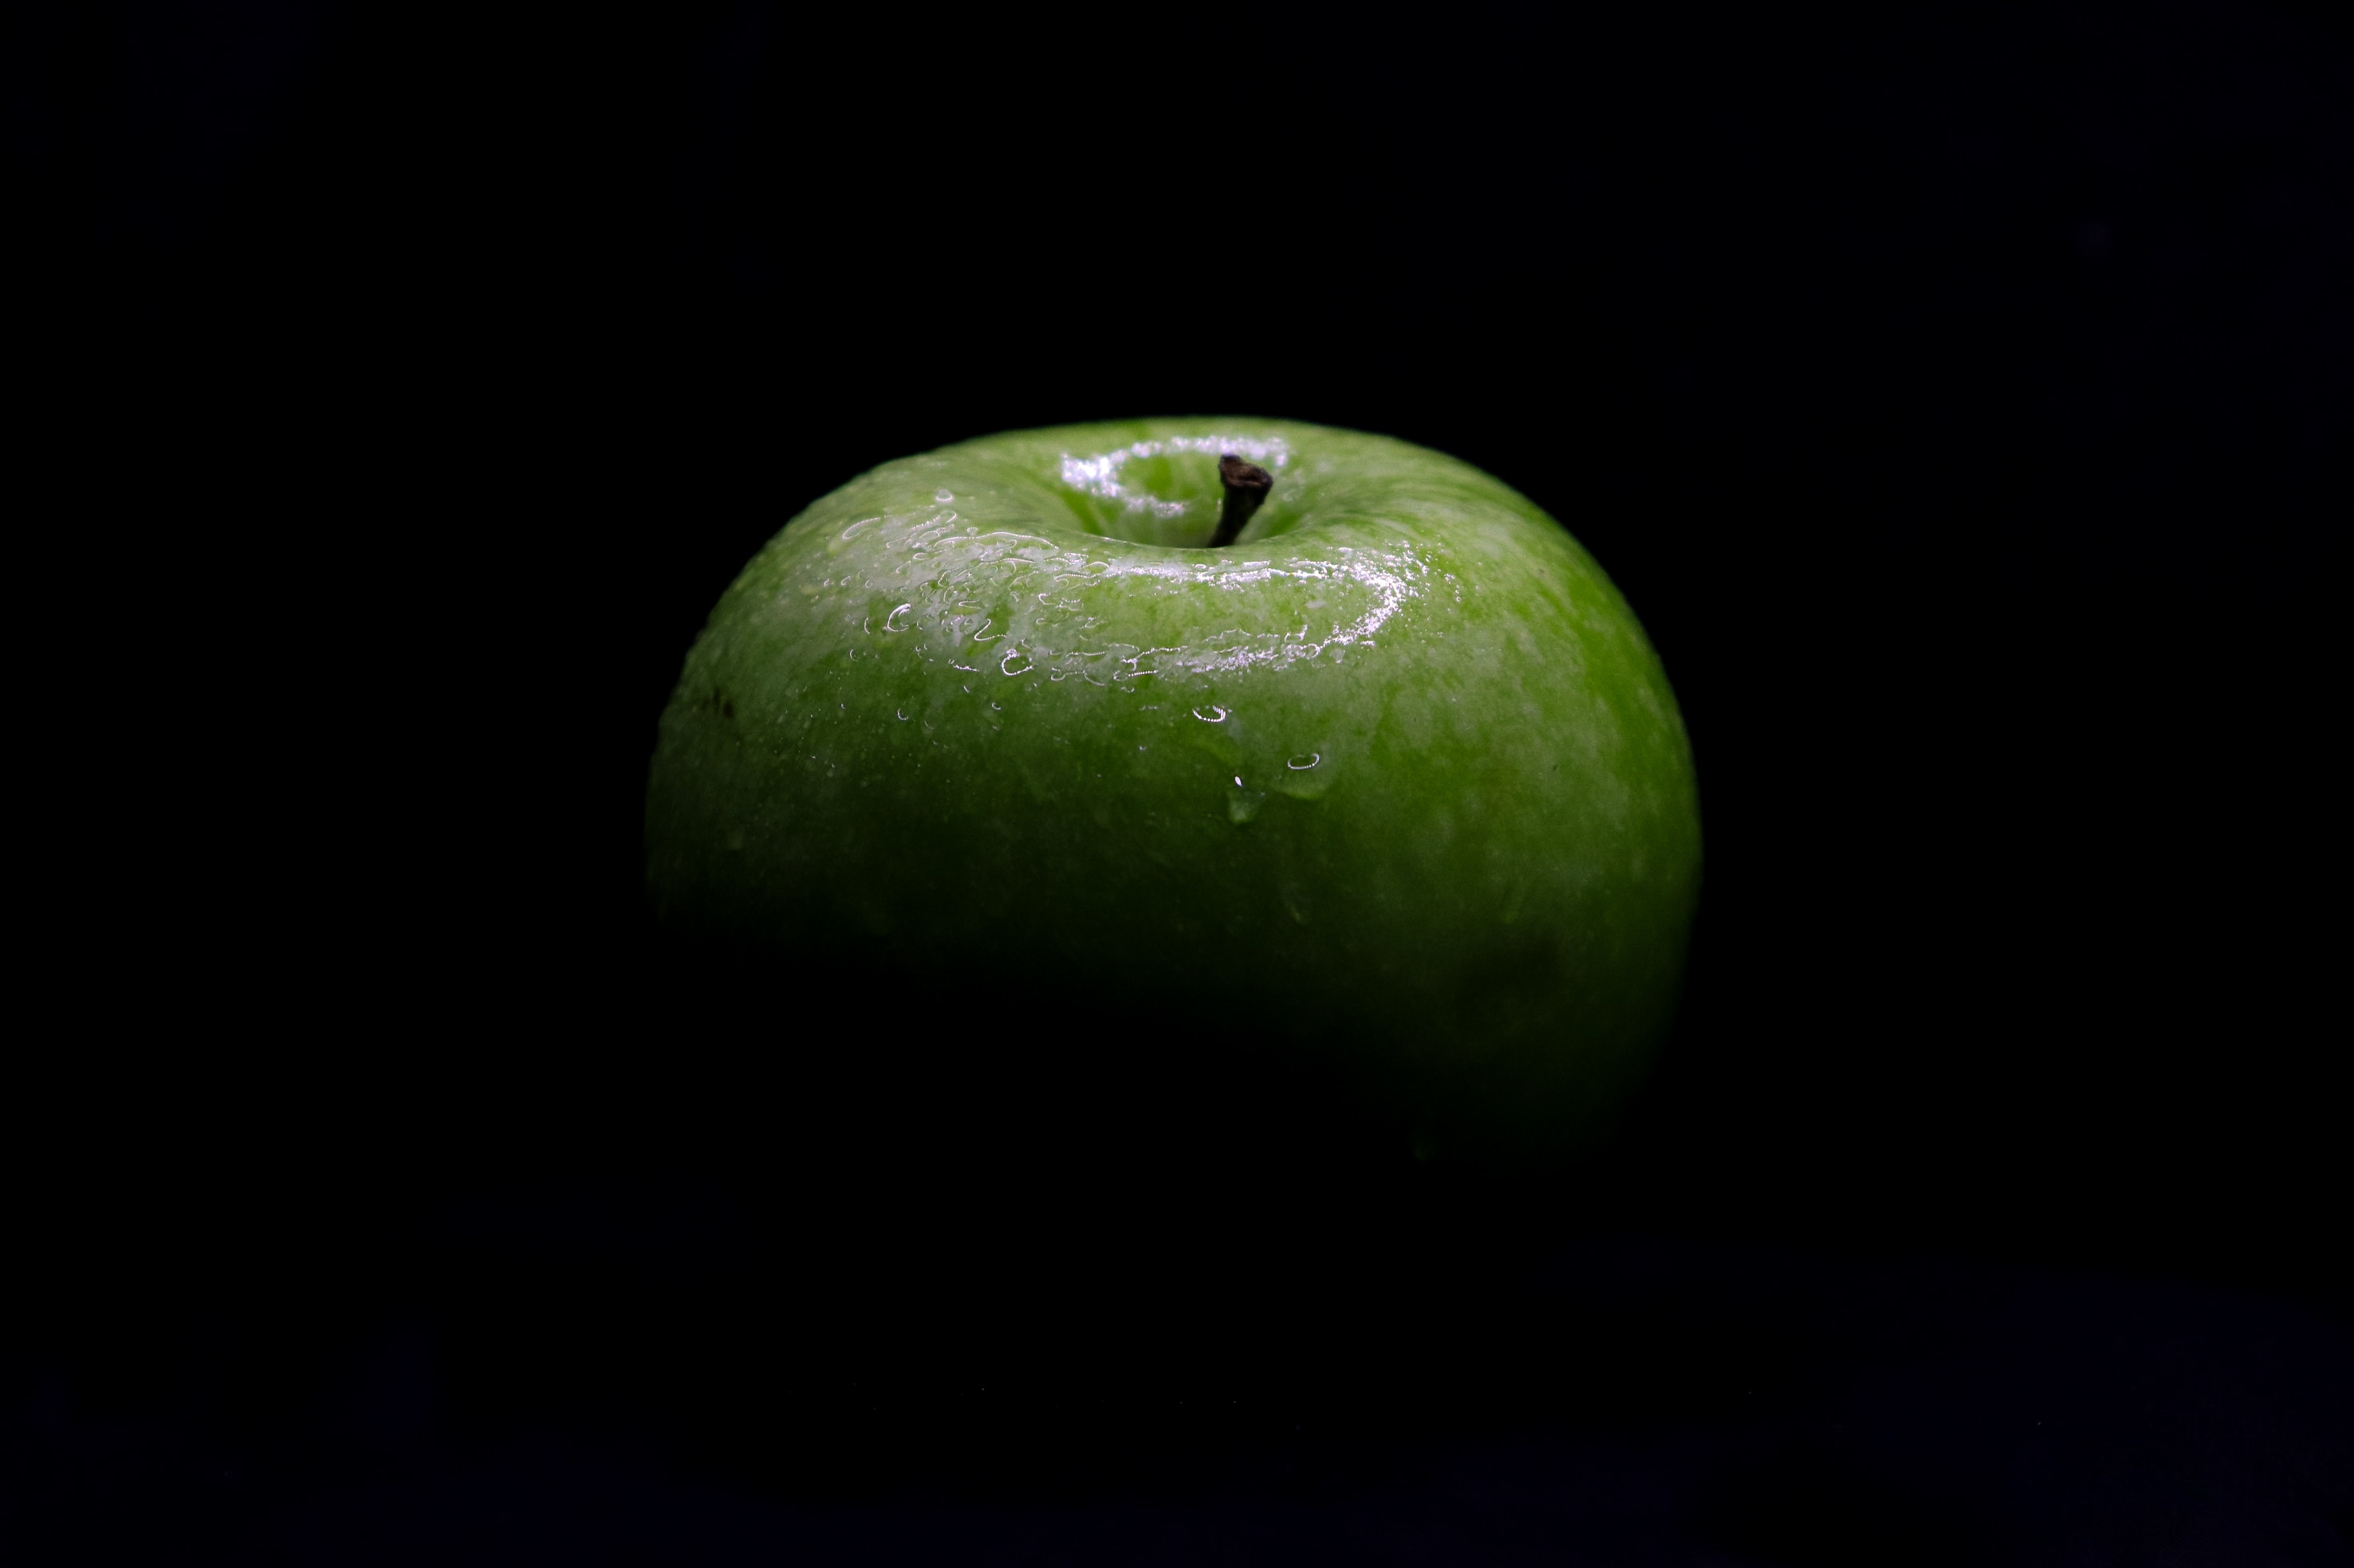
10101010101010101010101010101010101010101010101010101010101010101010101010101010
10101010101010101010101010101010101010101010101010101010101010101010101010101010
10101010101010101010101010101010101010101010101010101010101010101010101010101010
10101010101010101010101010101010101010101010101010101010101010101010101010101010
10101010101010101010101010101010101010101010101010101010101010101010101010101010
10101010101010101010101010101010101010101010101010101010101010101010101010101010
Center for Sustainable Food
10101010101010101010101010101010101010101010101010101010101010101010101010101010
10101010101010101010101010101010101010101010101010101010101010101010101010101010
10101010101010101010101010101010101010101010101010101010101010101010101010101010
10101010101010101010101010101010101010101010101010101010101010101010101010101010
10101010101010101010101010101010101010101010101010101010101010101010101010101010
10101010101010101010101010101010101010101010101010101010101010101010101010101010
Notes:
Center for Sustainable Food. A vision for the future. A thriving ecosystem. Stakeholders: industry (F&B and FMCG), Nutrition, Food-Tech, Health-Tech. Government (Ministry, Policy Makers, and Regulators - FSSAI). Not for Profit. NGO. Researchers. Consumers.

Slide 15

Notes:
Elon Musk. Mars. Why? ☺
2050. 10 Billion People. Sustainable food system. An existential matter for the civilization.

Slide 16

Complex Systems Laboratory, IIIT-Delhi
https://cosylab.iiitd.edu.in
Building Business with Computational Gastronomy APIs
Notes:
Computational Gastronomy API Dashboard. Open Access. Commercial Utility. Entrepreneurship.

Slide 17

Foodoscope Pvt. Ltd.
https://foodoscope.com
Building Business with Computational Gastronomy APIs
Notes:
Computational Gastronomy API Dashboard. Open Access. Commercial Utility. Entrepreneurship.

Slide 18
Foodoscope Pvt. Ltd.
https://foodoscope.com
Digital Building Blocks of Food, Recipe, Flavor, Nutrition with Computational Gastronomy APIs
Notes:
Computational Gastronomy API Dashboard. Open Access. Commercial Utility. Entrepreneurship.

Slide 19
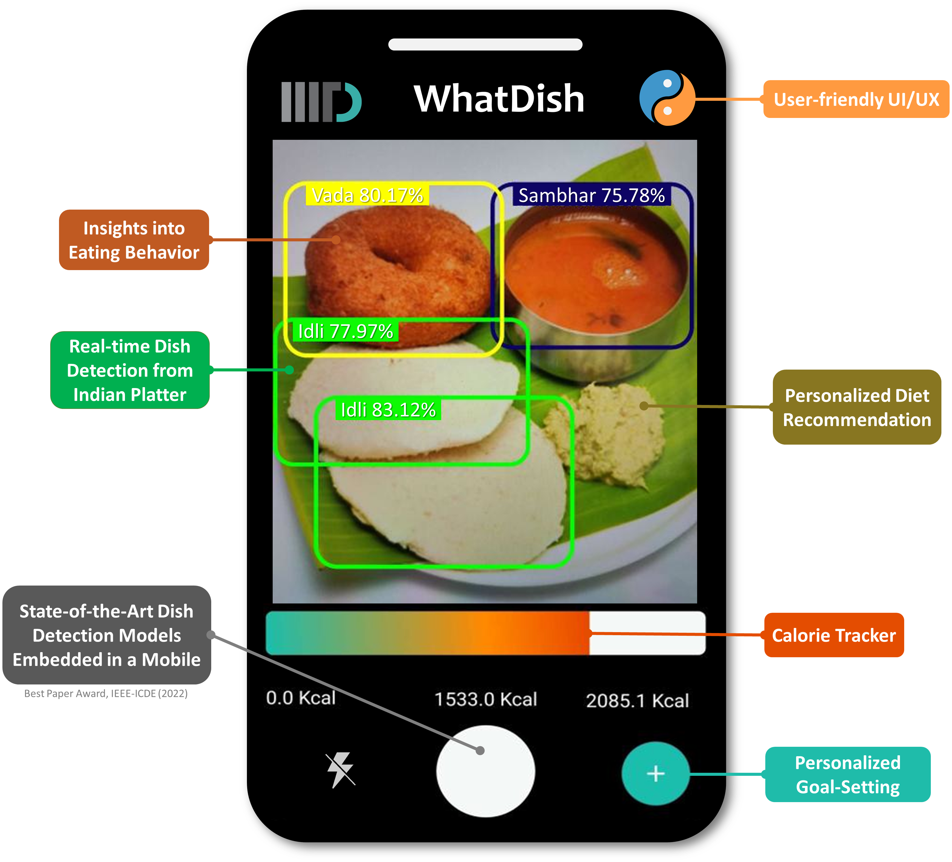
Notes:
Building application rooted in data and computation. Real-time dish detection.

Slide 20
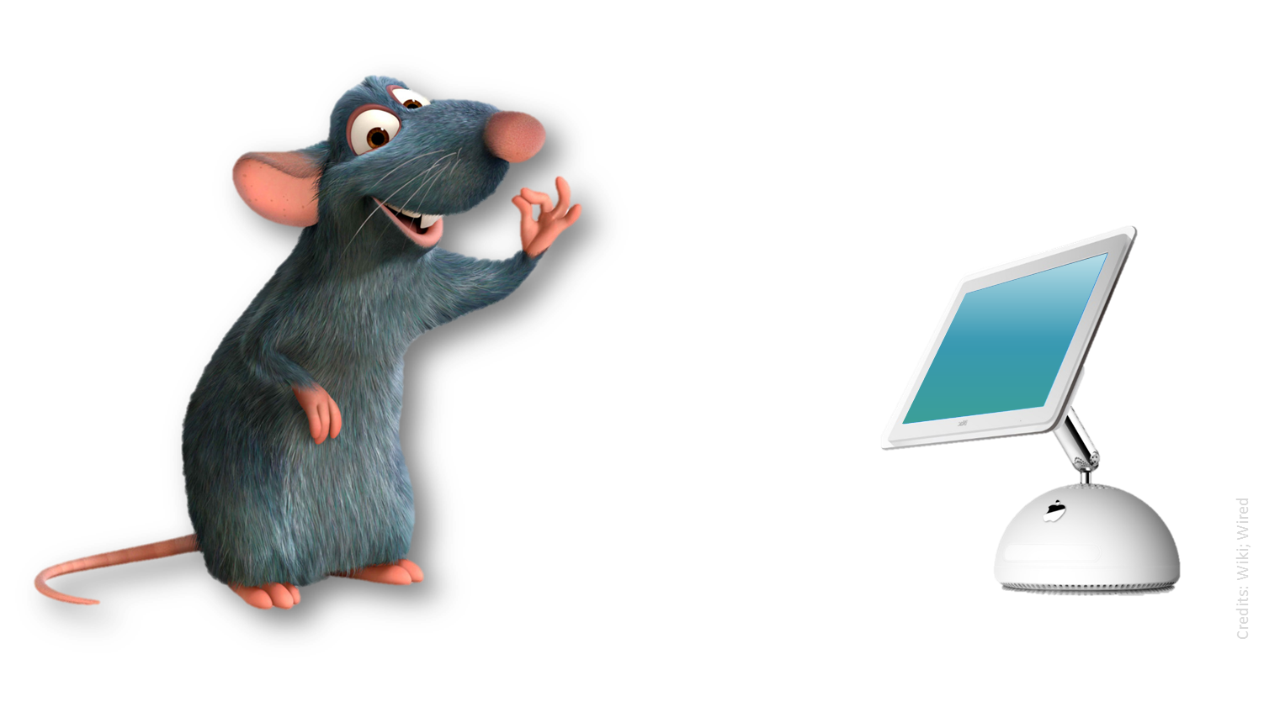
Ratatouille—Can Computers Cook?
Notes:
Can computers cook? Ratatouille. ☺ Remy. Chef Gusteau. Anyone can cook!

Slide 21
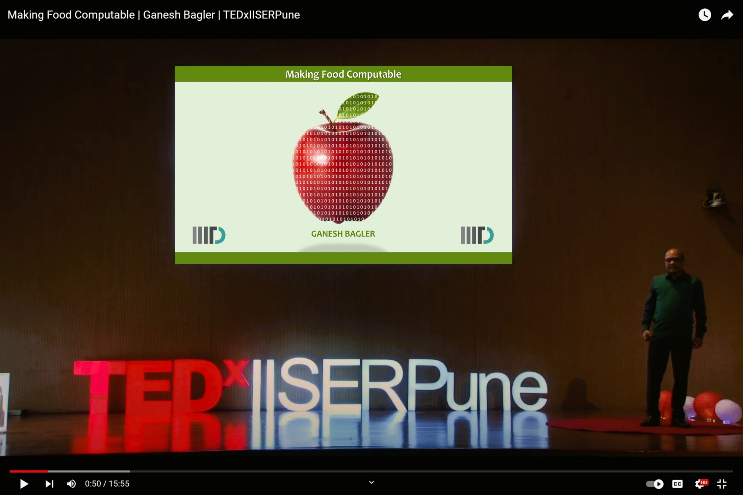
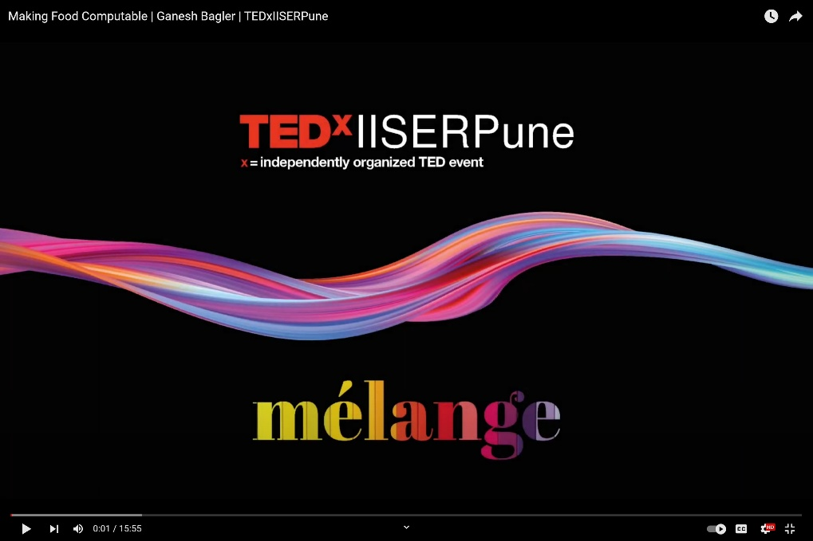
Making Food Computable
Notes:
The vision and mission: Making Food Computable

Slide 22

Complex Systems Laboratory, IIIT-Delhi
The Ground Zero of Computational Gastronomy
Making Food Computable
https://cosylab.iiitd.edu.in
Notes:
Complex Systems Laboratory. The Ground Zero of Computational Gastronomy. Resources: Data, algorithms.

Slide 23
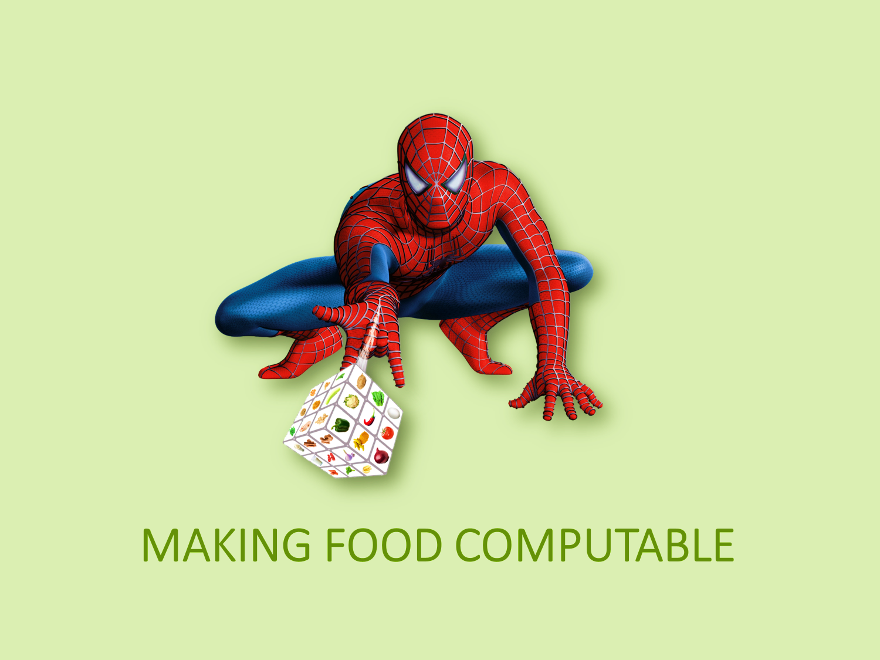
10101010101010101010101010101010101010101010101010101010101010101010101010101010
10101010101010101010101010101010101010101010101010101010101010101010101010101010
10101010101010101010101010101010101010101010101010101010101010101010101010101010
10101010101010101010101010101010101010101010101010101010101010101010101010101010
10101010101010101010101010101010101010101010101010101010101010101010101010101010
10101010101010101010101010101010101010101010101010101010101010101010101010101010
10101010101010101010101010101010101010101010101010101010101010101010101010101010
10101010101010101010101010101010101010101010101010101010101010101010101010101010
10101010101010101010101010101010101010101010101010101010101010101010101010101010
10101010101010101010101010101010101010101010101010101010101010101010101010101010
10101010101010101010101010101010101010101010101010101010101010101010101010101010
10101010101010101010101010101010101010101010101010101010101010101010101010101010
10101010101010101010101010101010101010101010101010101010101010101010101010101010
10101010101010101010101010101010101010101010101010101010101010101010101010101010
10101010101010101010101010101010101010101010101010101010101010101010101010101010
10101010101010101010101010101010101010101010101010101010101010101010101010101010
10101010101010101010101010101010101010101010101010101010101010101010101010101010
10101010101010101010101010101010101010101010101010101010101010101010101010101010
10101010101010101010101010101010101010101010101010101010101010101010101010101010
10101010101010101010101010101010101010101010101010101010101010101010101010101010
10101010101010101010101010101010101010101010101010101010101010101010101010101010
10101010101010101010101010101010101010101010101010101010101010101010101010101010
10101010101010101010101010101010101010101010101010101010101010101010101010101010
10101010101010101010101010101010101010101010101010101010101010101010101010101010
10101010101010101010101010101010101010101010101010101010101010101010101010101010
Notes:
The mantra! The mission: Making Food Computable. Leveraging data and algorithms for understanding food and designing applications.

Slide 24
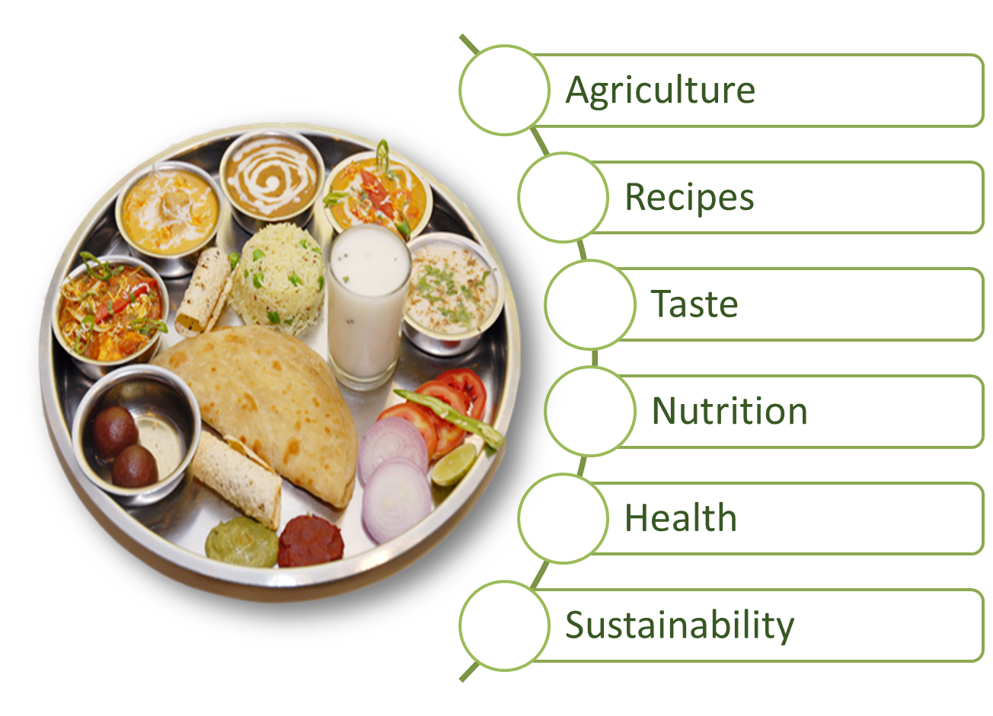
Notes:
From Farm To Fork. Data Compilation, Curation, Analysis, Prediction.

Slide 25

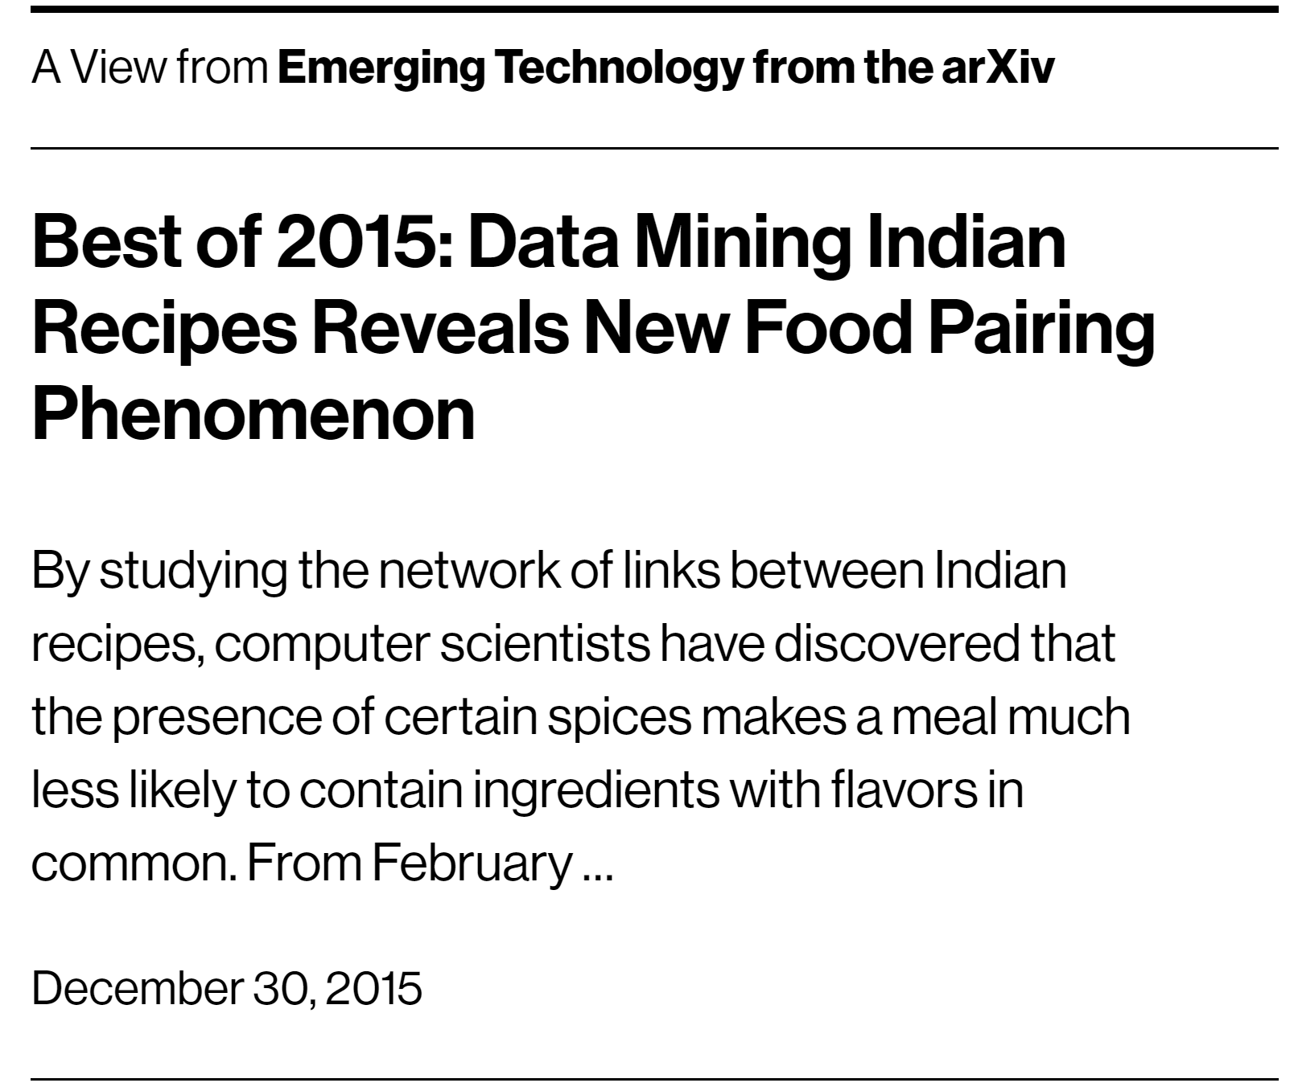


Best of 2015
MIT Technology Review
By studying the network of links between Indian recipes, computer scientists have discovered that the presence of certain spices makes a meal much less likely to contain Ingredients with flavors in common.
Jain, Rakhi and Bagler*, arXiv (2015) | Jain, Rakhi and Bagler*, PLoS One (2015)
Notes:
MIT Technology Review. Emerging Technology. Best of 2015.

Slide 26
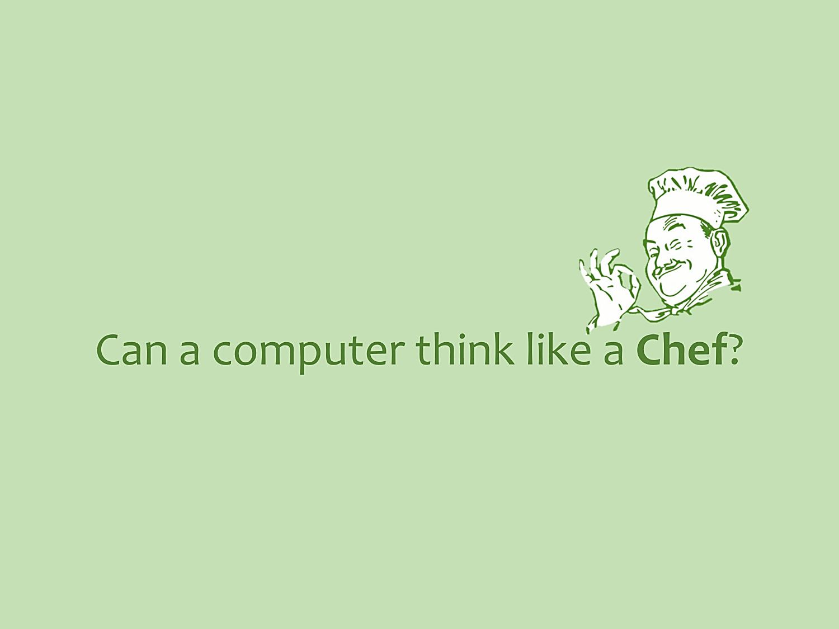
10101010101010101010101010101010101010101010101010101010101010101010101010101010
10101010101010101010101010101010101010101010101010101010101010101010101010101010
10101010101010101010101010101010101010101010101010101010101010101010101010101010
10101010101010101010101010101010101010101010101010101010101010101010101010101010
10101010101010101010101010101010101010101010101010101010101010101010101010101010
10101010101010101010101010101010101010101010101010101010101010101010101010101010
10101010101010101010101010101010101010101010101010101010101010101010101010101010
10101010101010101010101010101010101010101010101010101010101010101010101010101010
10101010101010101010101010101010101010101010101010101010101010101010101010101010
10101010101010101010101010101010101010101010101010101010101010101010101010101010
10101010101010101010101010101010101010101010101010101010101010101010101010101010
10101010101010101010101010101010101010101010101010101010101010101010101010101010
10101010101010101010101010101010101010101010101010101010101010101010101010101010
10101010101010101010101010101010101010101010101010101010101010101010101010101010
10101010101010101010101010101010101010101010101010101010101010101010101010101010
10101010101010101010101010101010101010101010101010101010101010101010101010101010
10101010101010101010101010101010101010101010101010101010101010101010101010101010
10101010101010101010101010101010101010101010101010101010101010101010101010101010
10101010101010101010101010101010101010101010101010101010101010101010101010101010
10101010101010101010101010101010101010101010101010101010101010101010101010101010
10101010101010101010101010101010101010101010101010101010101010101010101010101010
10101010101010101010101010101010101010101010101010101010101010101010101010101010
10101010101010101010101010101010101010101010101010101010101010101010101010101010
10101010101010101010101010101010101010101010101010101010101010101010101010101010
10101010101010101010101010101010101010101010101010101010101010101010101010101010
Notes:
Can computers think like a chef? Can we capture the intelligence and intuition of a Chef in a computer program?

Slide 27
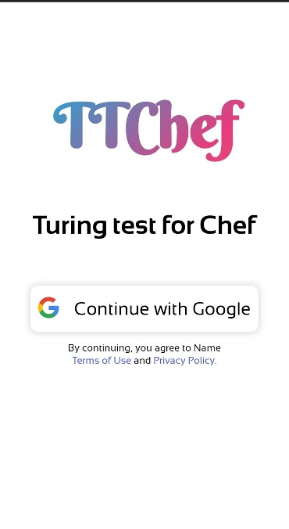
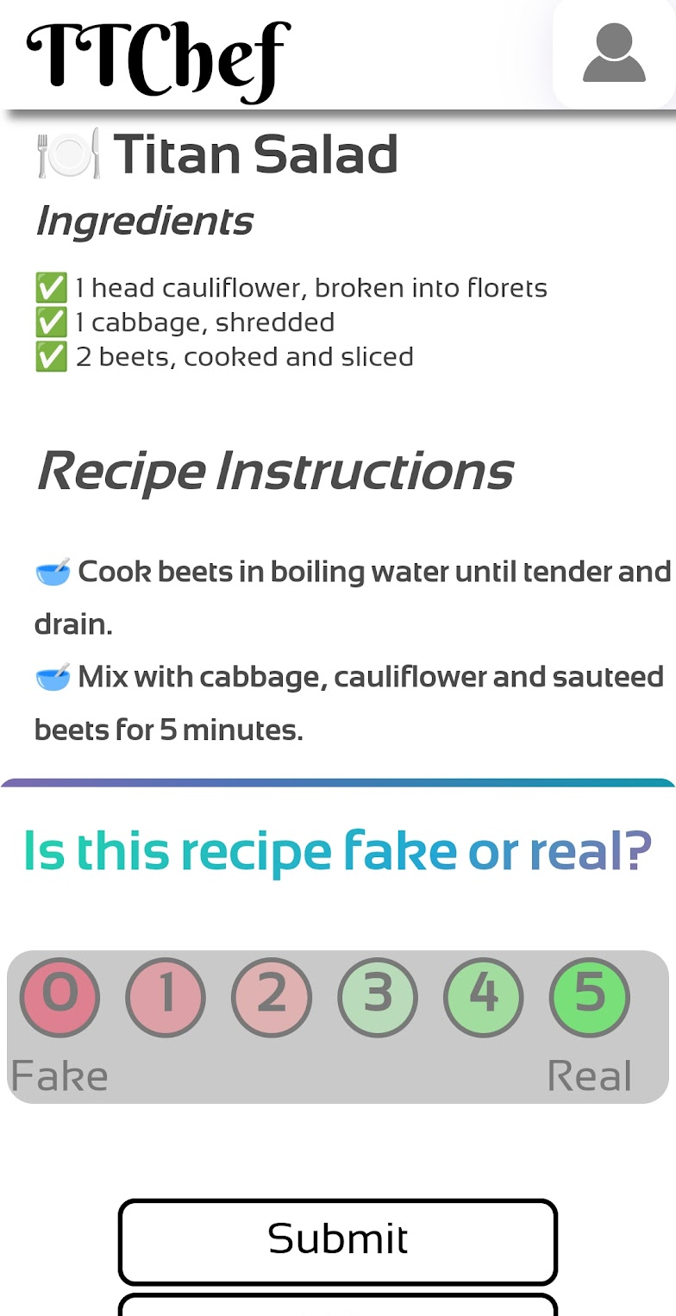
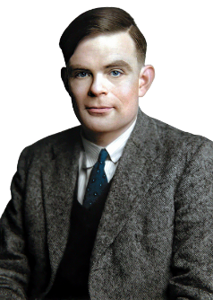
Turing Test for Chef
Building on the inquiry of Alan Turing
Bagler* et al., ‘The Turing Test for Chef,’ Under preparation (2023)
Notes:
Alan Turing. 1955. Can machines think? Can machines think like a chef? The Turing Test for Chef.

Slide 28

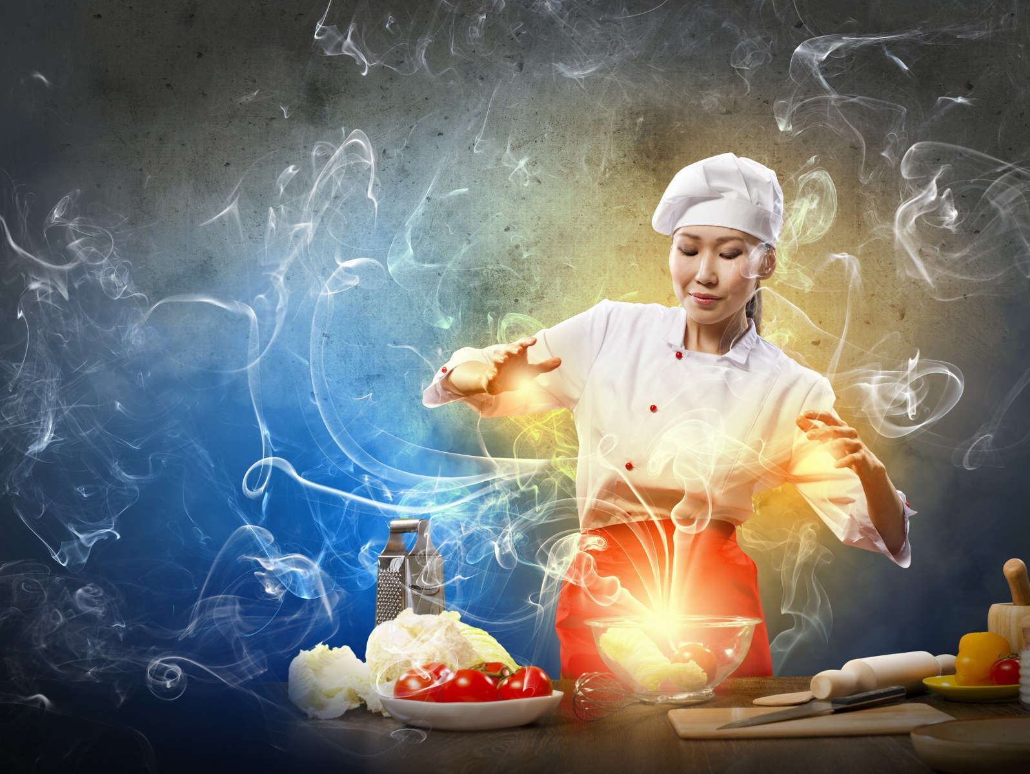



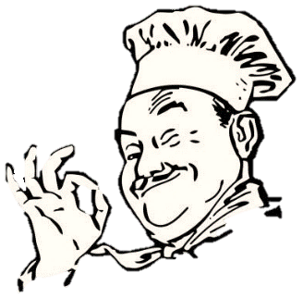
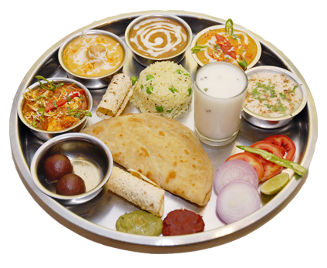

The proof is in the pudding!
Scattered Knowledge
Structured
Data
Fine-tuned
Model
Generative
Algorithms
Turing Test
Strategy
AI-driven recipes
Notes:
Consolidation of the process behind Ratatouille.

Slide 29
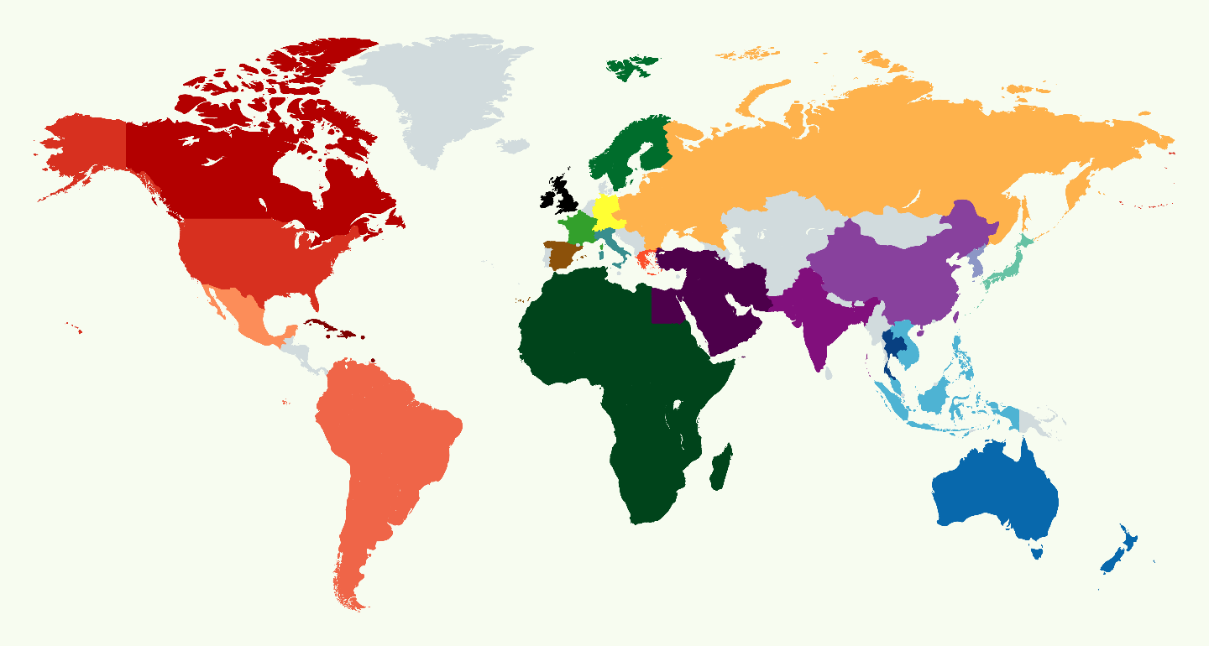
Culinary Fingerprints of the World Cuisines
Singh and Bagler*, IEEE International Conference on Data Engineering, DÉCOR, Paris (2018)
Notes:
The world was our canvas. Databases of global cuisines. Culinary fingerprints. Idiosyncratic features of cuisines. Paris – the Mecca of gastronomy. Best paper award.

Slide 30
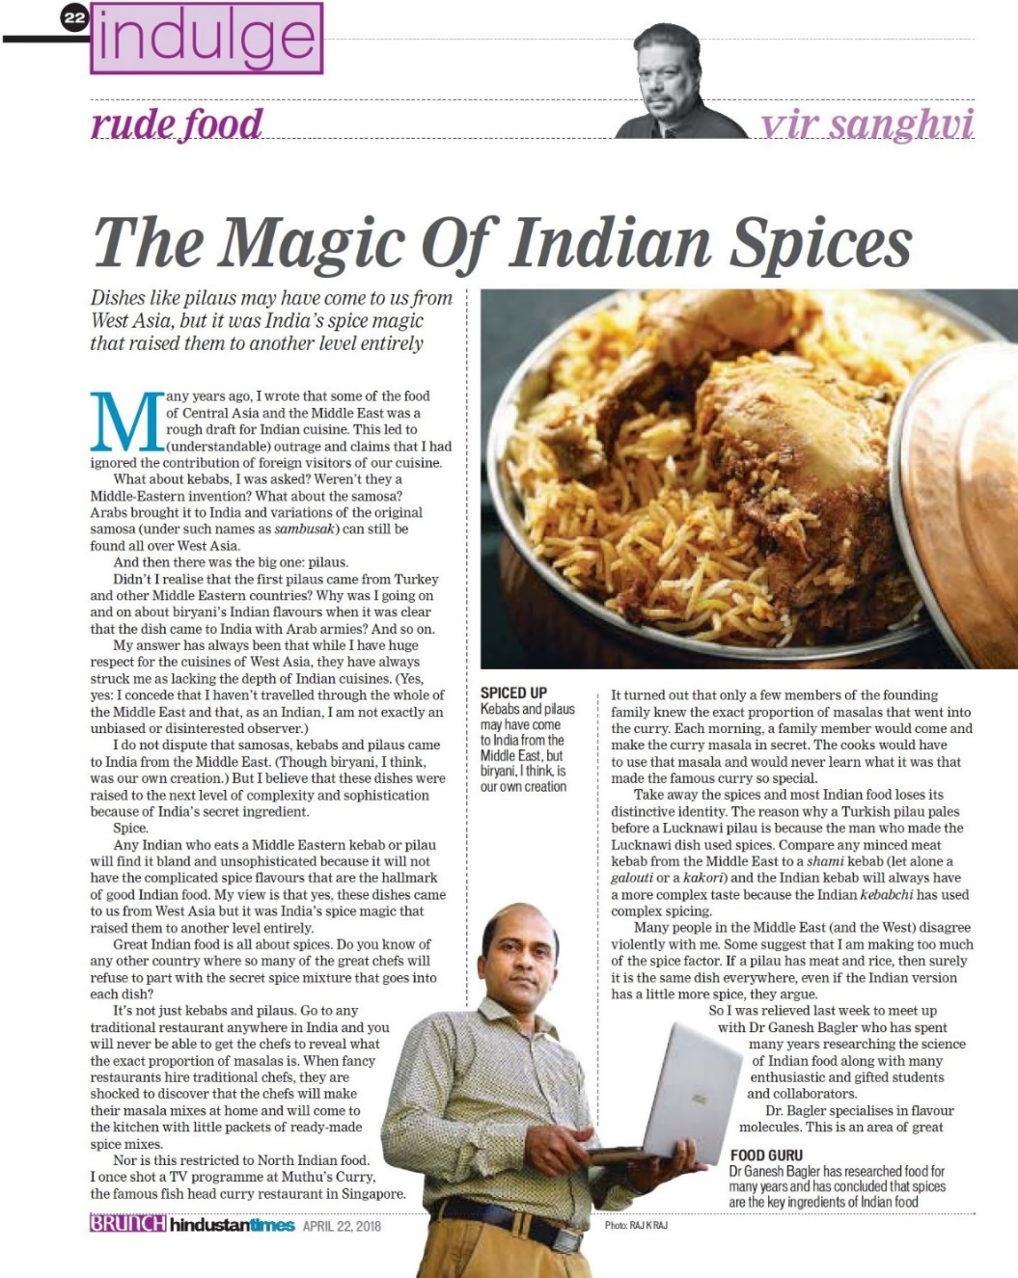
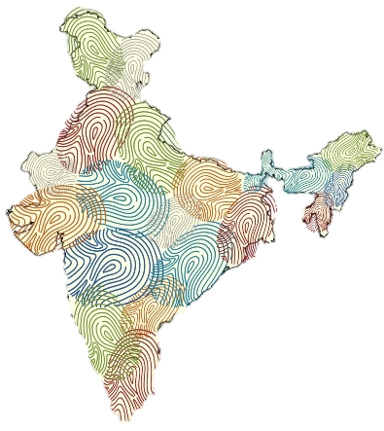
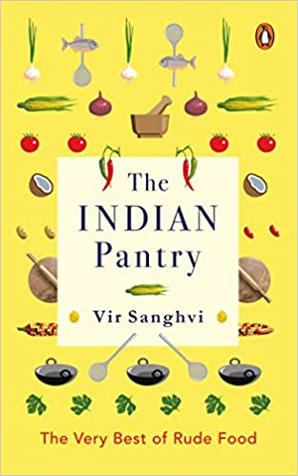
The Indian Magic
Notes:
Chefs and Food Critics. Uniqueness and identity of the Indian cuisine shown through data-driven analysis.

Slide 31


Notes:
Academia was not far behind in acknowledging the potential of our research. Roya Society of Chemistry.

Slide 32
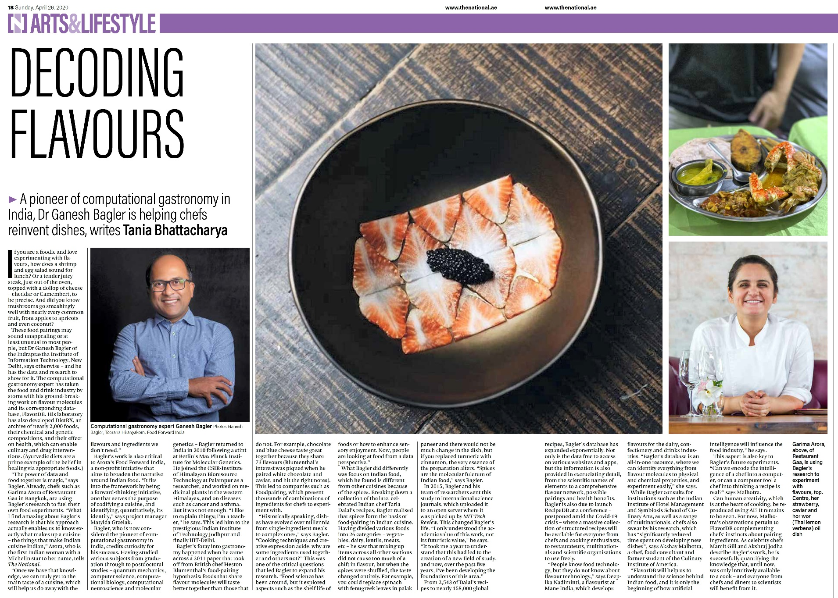
A New Data Science of Food
Notes:
Chefs and culinary enthusiasts have been upbeat about the Computational Gastronomy research.
Chefs, flavorists, and food technologists are the wizards of food, cooking and food processing.

Slide 33
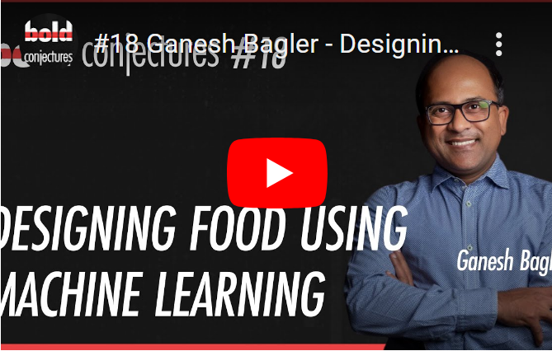

Slide 34

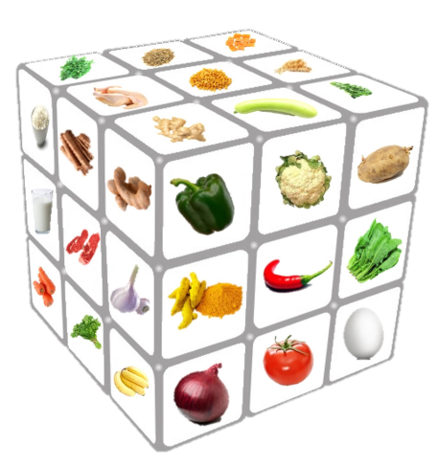
Cooking is alchemy
Notes:
Cooking is magic! Culture. Culinary diversity.

Slide 35
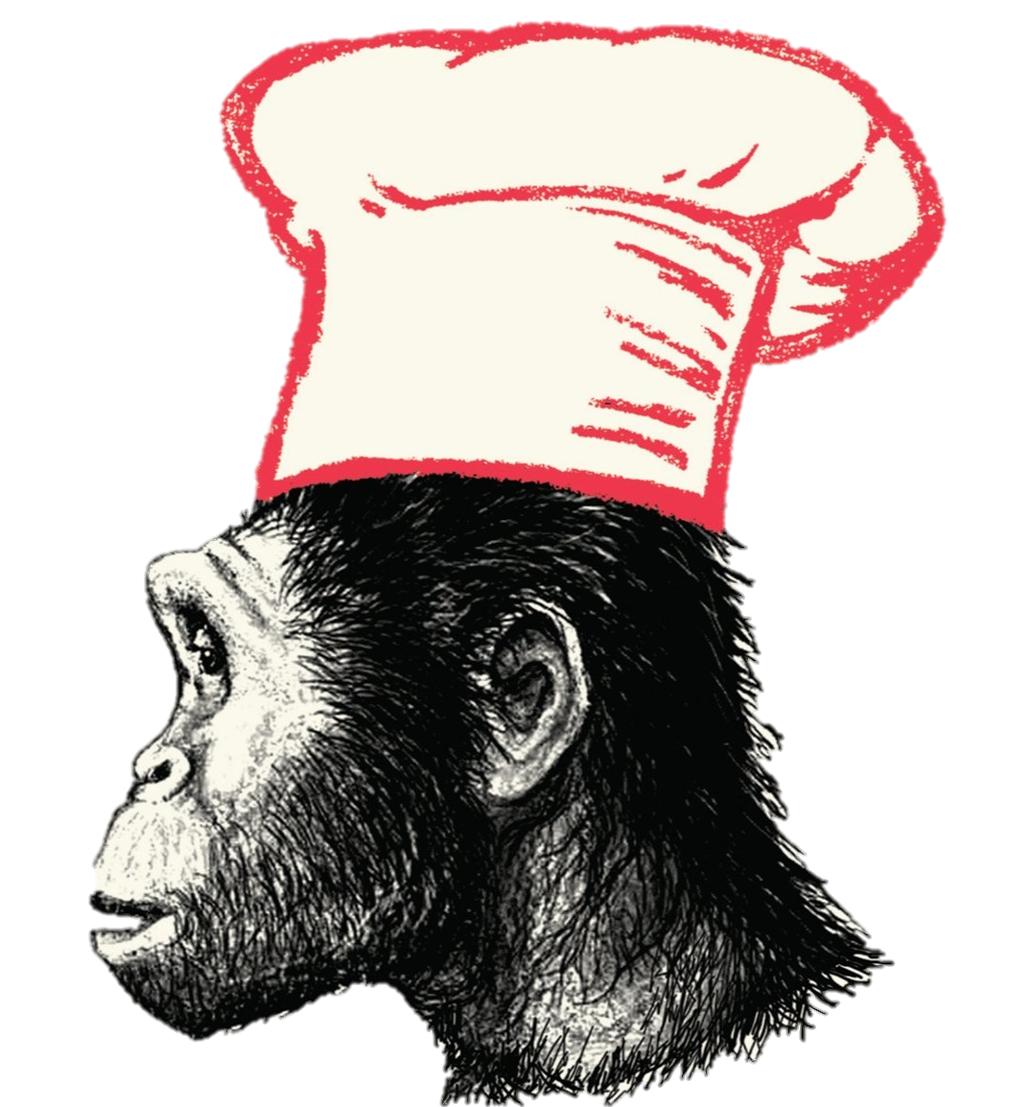
Being Human
‘Catching Fire—How cooking made us human’ by Richard Wrangham
Notes:
Food processing began with the earliest human roasting their food.
Cooking – the essence of being human.

Slide 36
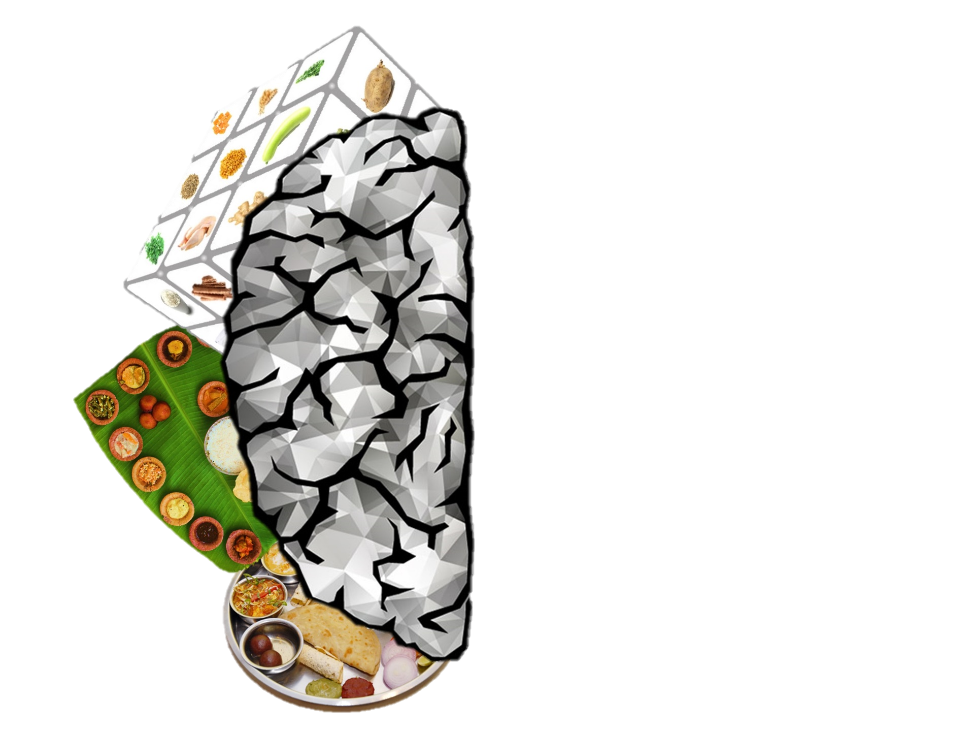

Being Human
Notes:
Cooking. Critical for evolution of disproportionately large brain size. The seat of cognition, consciousness, abstract thinking, creative endeavors.

Slide 37
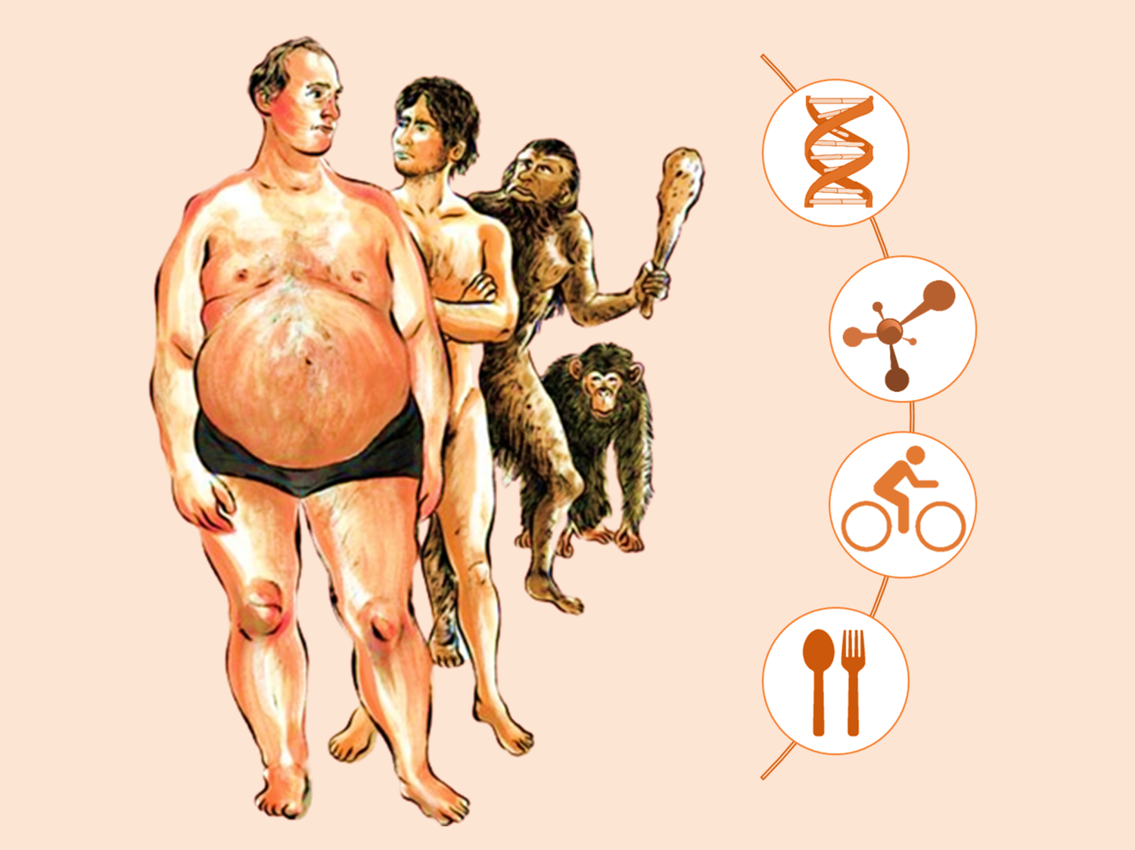
The Epidemic of Lifestyle Disorders
Notes:
Retro-evolution? ☺
The epidemic of lifestyle disorders. Obesity, type-2 diabetes, cardiovascular disorders. Diet.

Slide 38

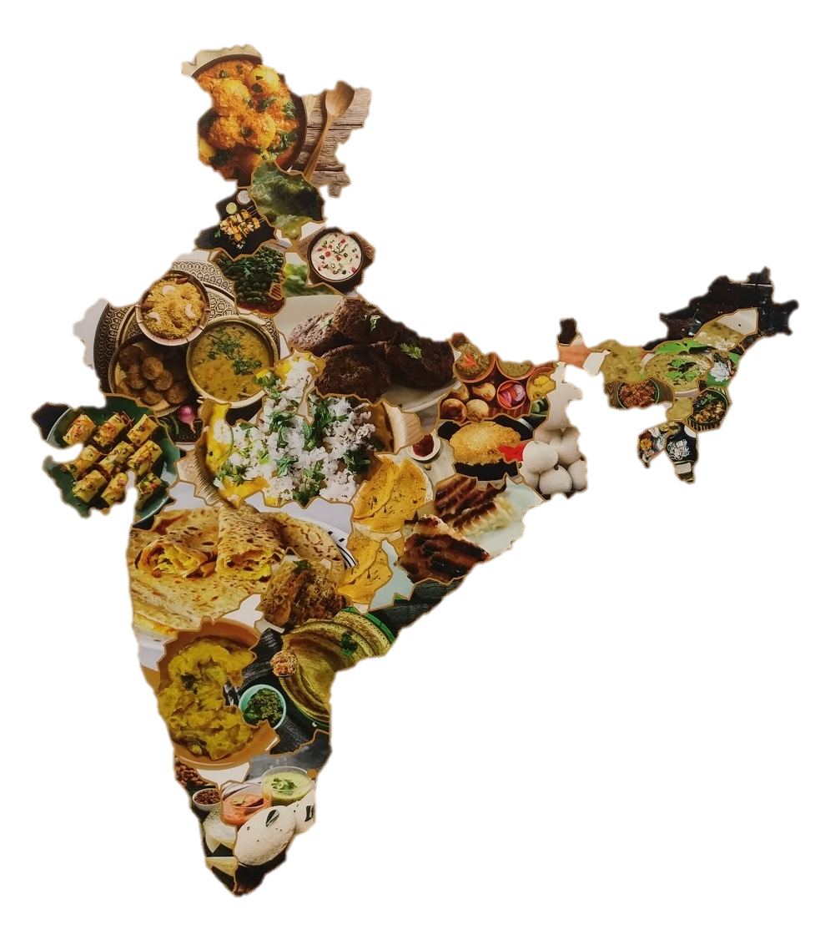
India—A potpourri of cultures with
a rich and diverse culinary heritage
Diverse
Culture-rich
Wellbeing-centric
Ganesh Bagler*, ‘The digital way forward for the Indian Cuisine’ (2019)
Notes:
India. Diverse. Culturally rich. Health-centric dietary practices.

Slide 39

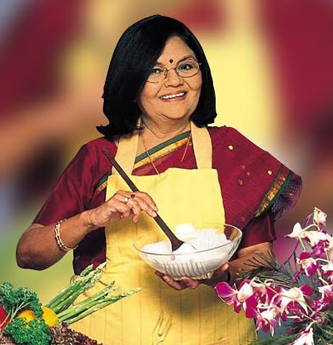
Data is the New Oil
Notes:
Where is the data? Cookbooks. Tarla Dalal. Data of Indian recipes.

Slide 40
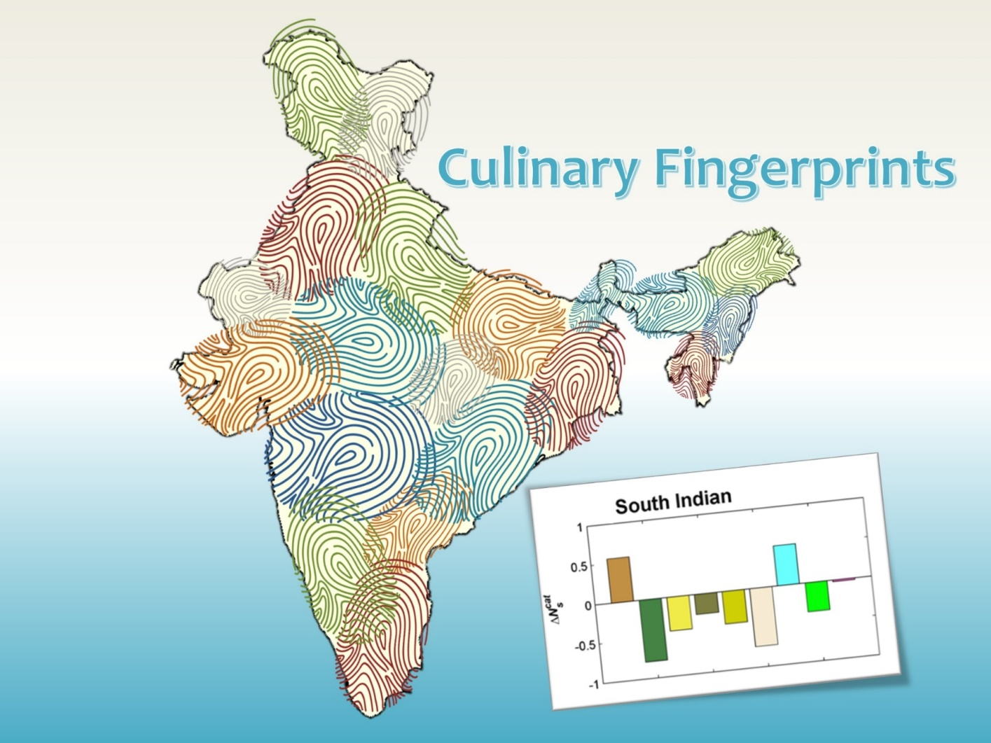
Notes:
Capturing the identity of a cuisine in a vector. Defining the culinary fingerprints.

Slide 41

Jain, Rakhi, and Bagler*, ‘Analysis of Food Pairing in Regional Cuisines of India,’ PLoS One (2015)
Notes:
Spice is the molecular fulcrum of Indian recipes. Unique class of ingredients that are central to Indian recipes.

Slide 42


Taste Prediction
Bitter
Sweet
Notes:
Hedonic aspects of food. Predicting taste as (classification problem). Sweetness prediction (regression problem).

Slide 43





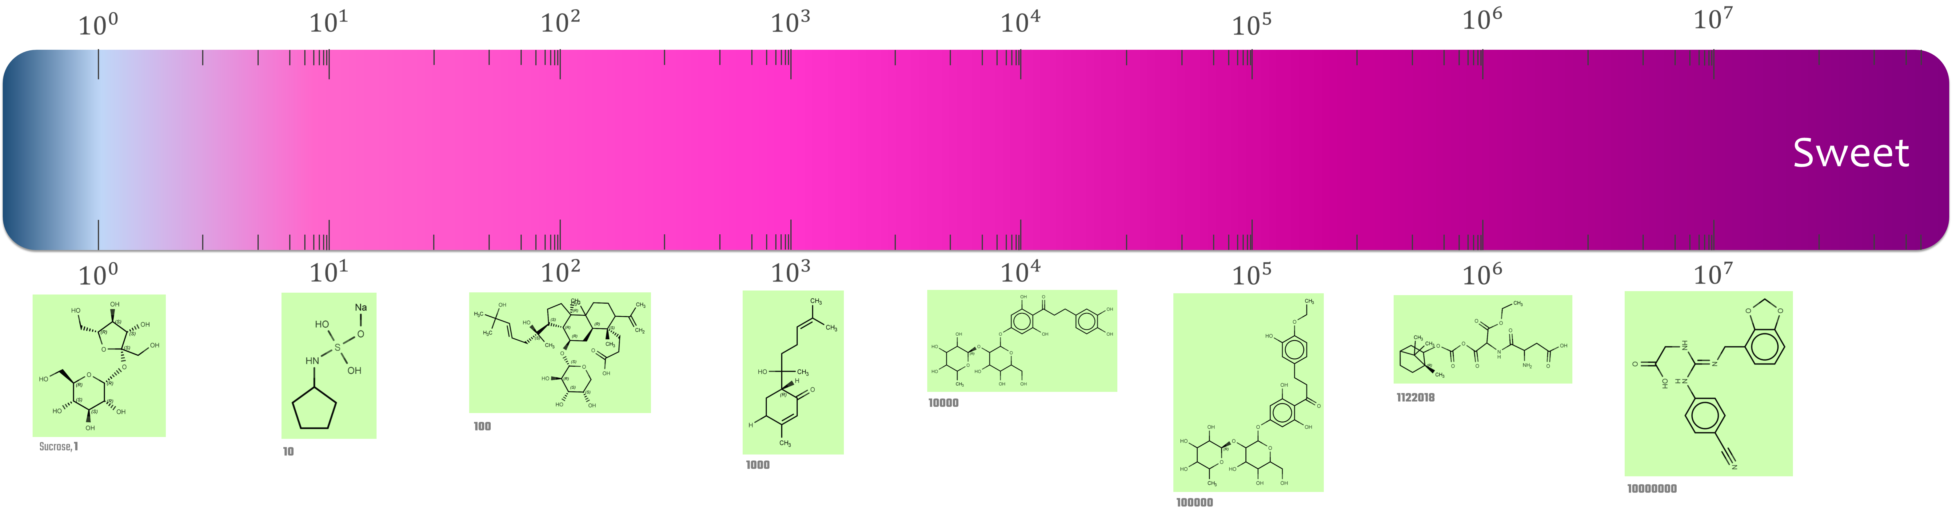
Sweetness Prediction
Computers in Biology & Medicine (2022)
https://cosylab.iiitd.edu.in/sweetpred
Notes:
Hedonic aspects of food. Predicting taste as (classification problem). Sweetness prediction (regression problem).

Slide 44

Meal-as-a-Medicine?
https://cosylab.iiitd.edu.in/DietRx
https://cosylab.iiitd.edu.in/SpiceRx
Rakhi, Tuwani, Garg, Mukherjee & Bagler* bioRxiv (2018) | Tuwani, Rakhi & Bagler* (2019) | Rakhi, Tuwani, Mukherjee & Bagler* PLoS ONE (2018)
Notes:
Complexity of how food interacts with body giving rise to health consequences.
Could we assess the health impacts of food on human body? Compiling data of published literature.

Slide 45
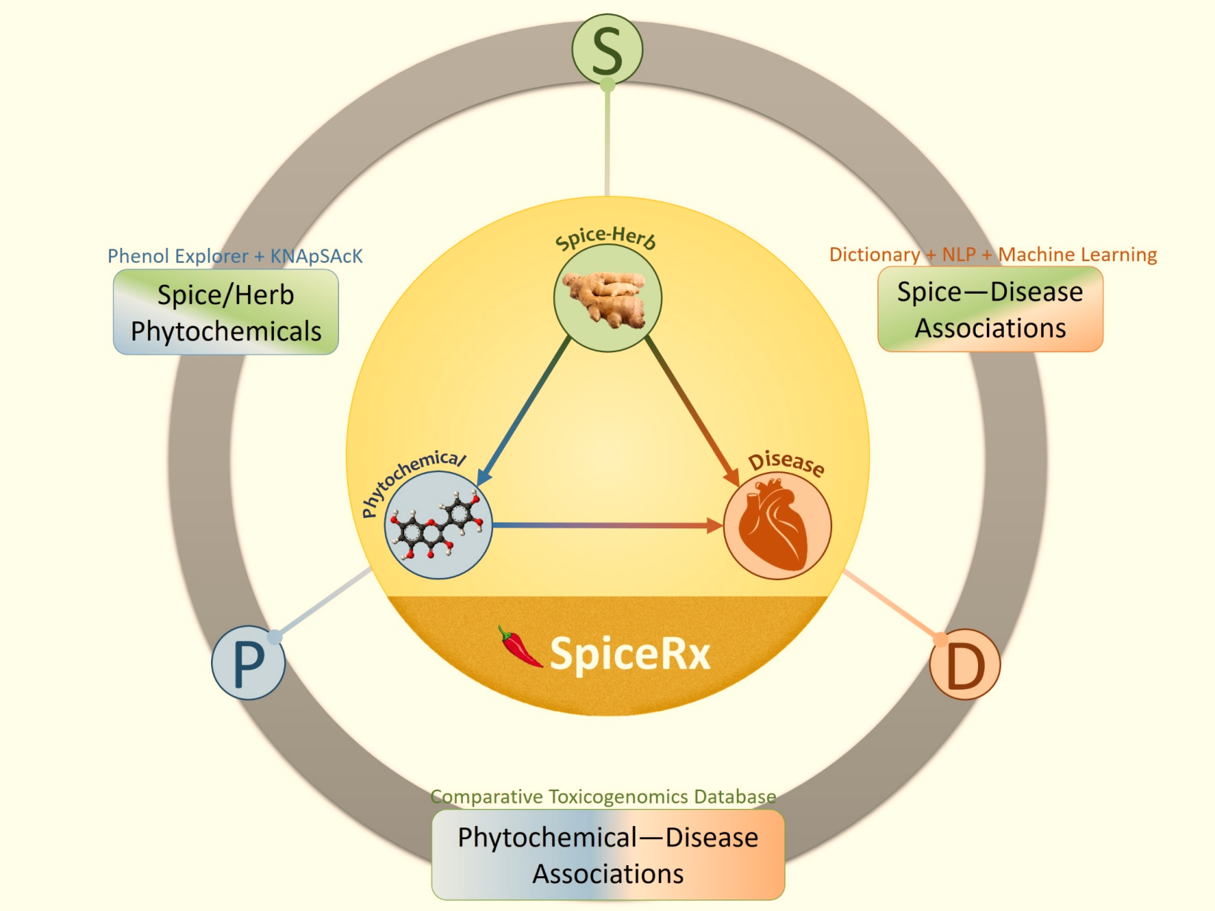
https://cosylab.iiitd.edu.in/spicerx
SpiceRx: Spices & Health
Rakhi, Tuwani, Garg, Mukherjee, and Bagler* bioRxiv (2018) | Rakhi, Tuwani, Mukherjee, and Bagler* PLoS ONE (2018)
Notes:
Could we assess the health impacts of food on human body? Compiling data of published literature. Herbs and Spices.

Slide 46
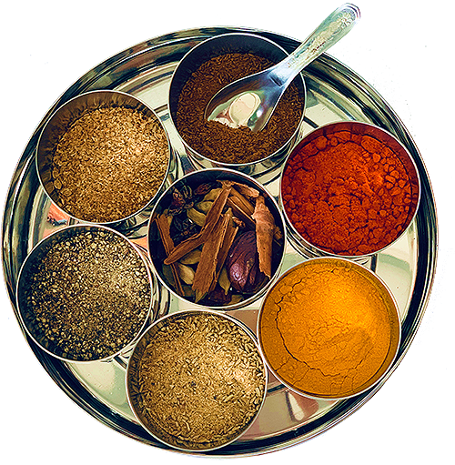
Why Spices?
‘Data-driven analysis of biomedical literature suggests broad-spectrum benefits of culinary herbs and spices,’ PLoS ONE (2018)
Notes:
Why spices? Herbs spices and their health impacts. Diet design. Nutraceuticals.

Slide 47
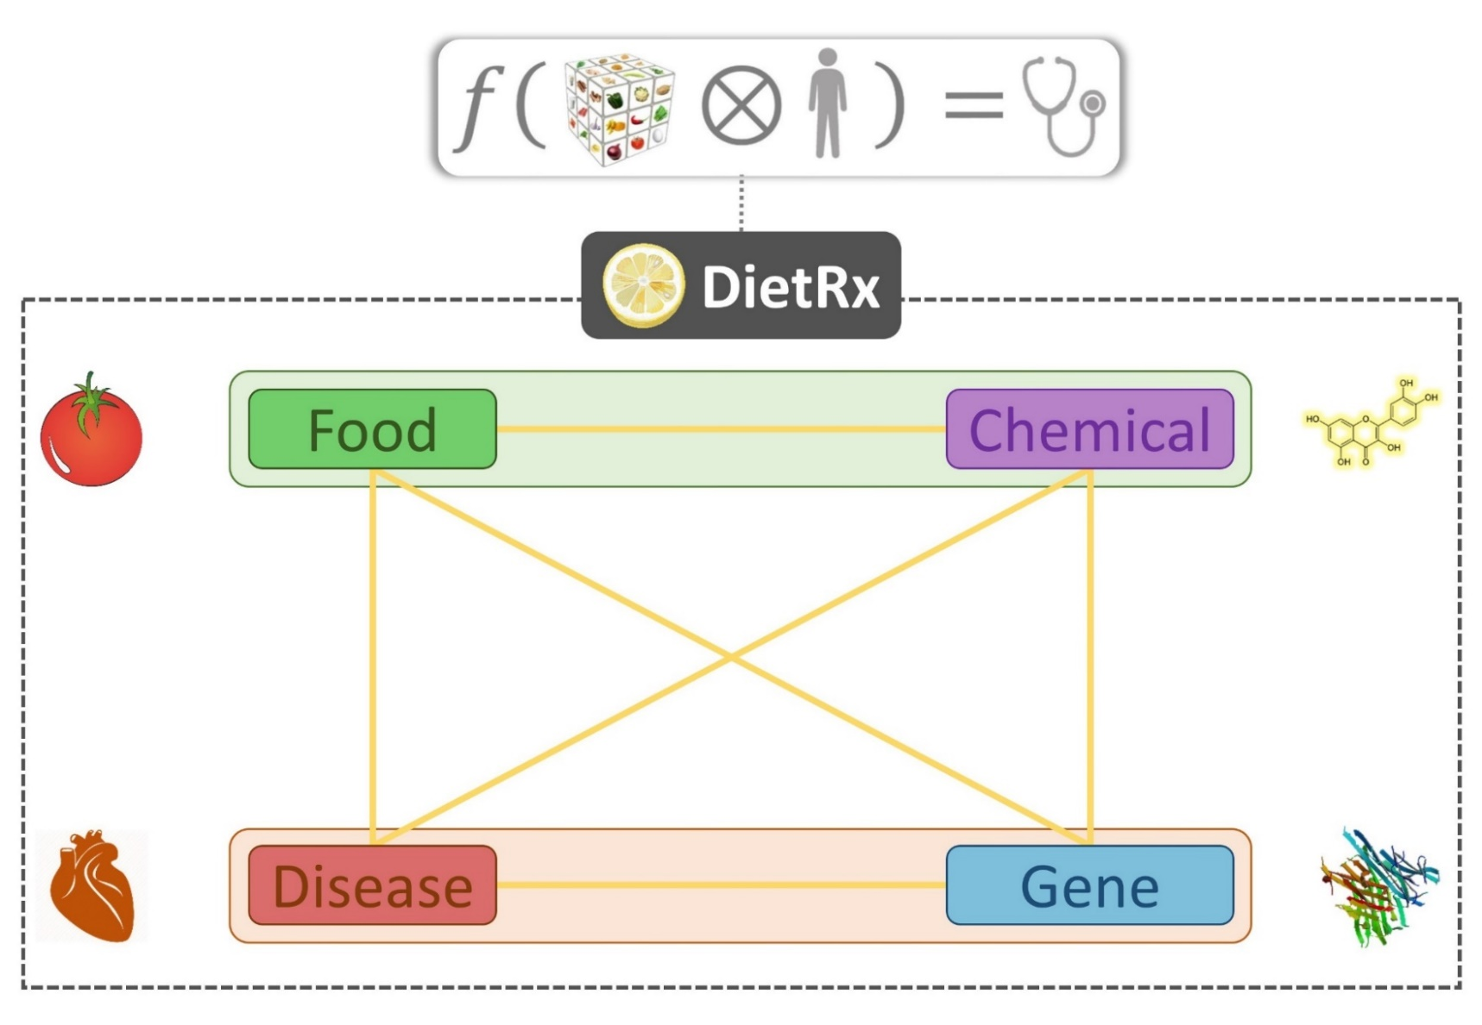
R Tuwani, Rakhi NK, N Garg and G Bagler*, under review; R Tuwani, Rakhi NK, and G Bagler*, under review.
Notes:
We are building DietRx, an integrated resource for health impacts of around 2000 culinary ingredients and their health effects coming from scientific reports.

Slide 48
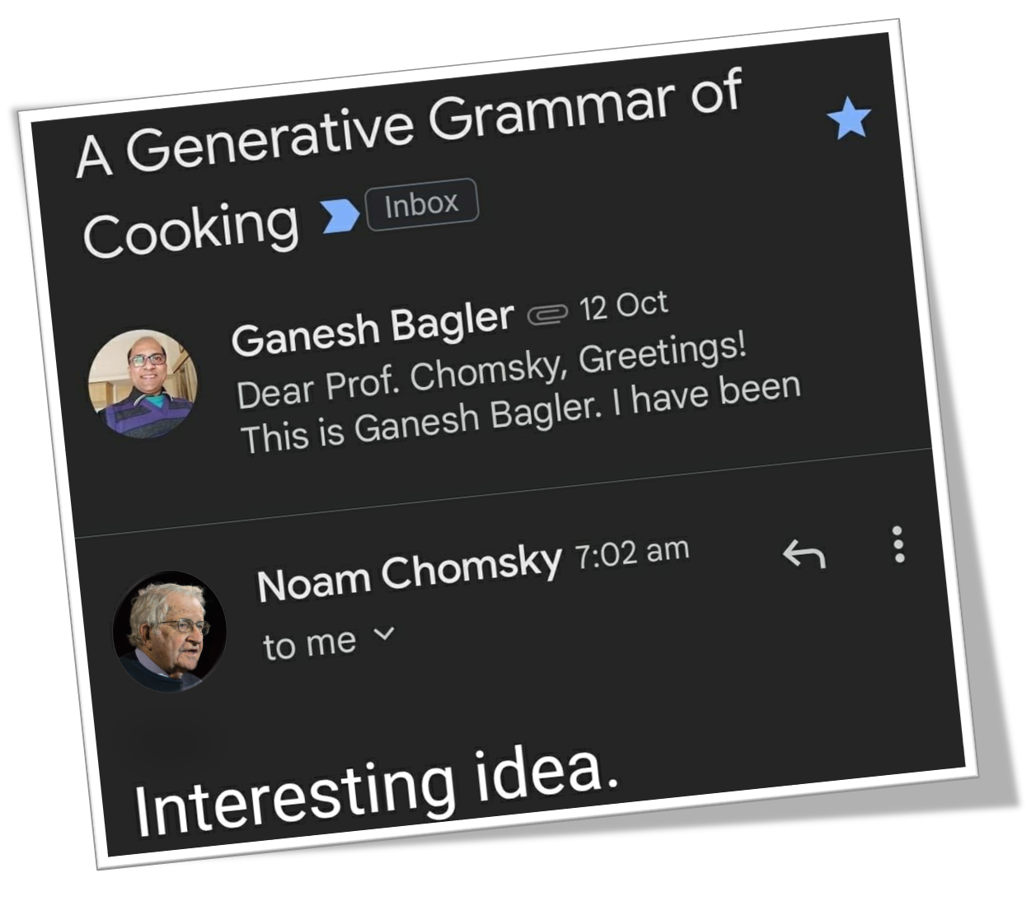
Ganesh Bagler*, ‘A generative grammar of cooking,’ arXiv:2211.09059 (2022)
Notes:
Is there underlying grammar for the process of cooking? Linguistics. Panini. Noam Chomsky.
A generative grammar of cooking. A grammar for food processing?

Slide 49
Personalized Nutrition
Gut Microbes
Blood tests
Questionnaires
Body Mass Index
Food diary
Design personalized diet to lower glucose levels
Sonnenburg and Sonnenburg, Nature (2015)
Zeevi et al., ‘Personalized nutrition by prediction of glycemic response,’ Cell (2015)
Notes:
Personalized nutrition. Dietary intervention for better nutritional and health outcomes.

Slide 50
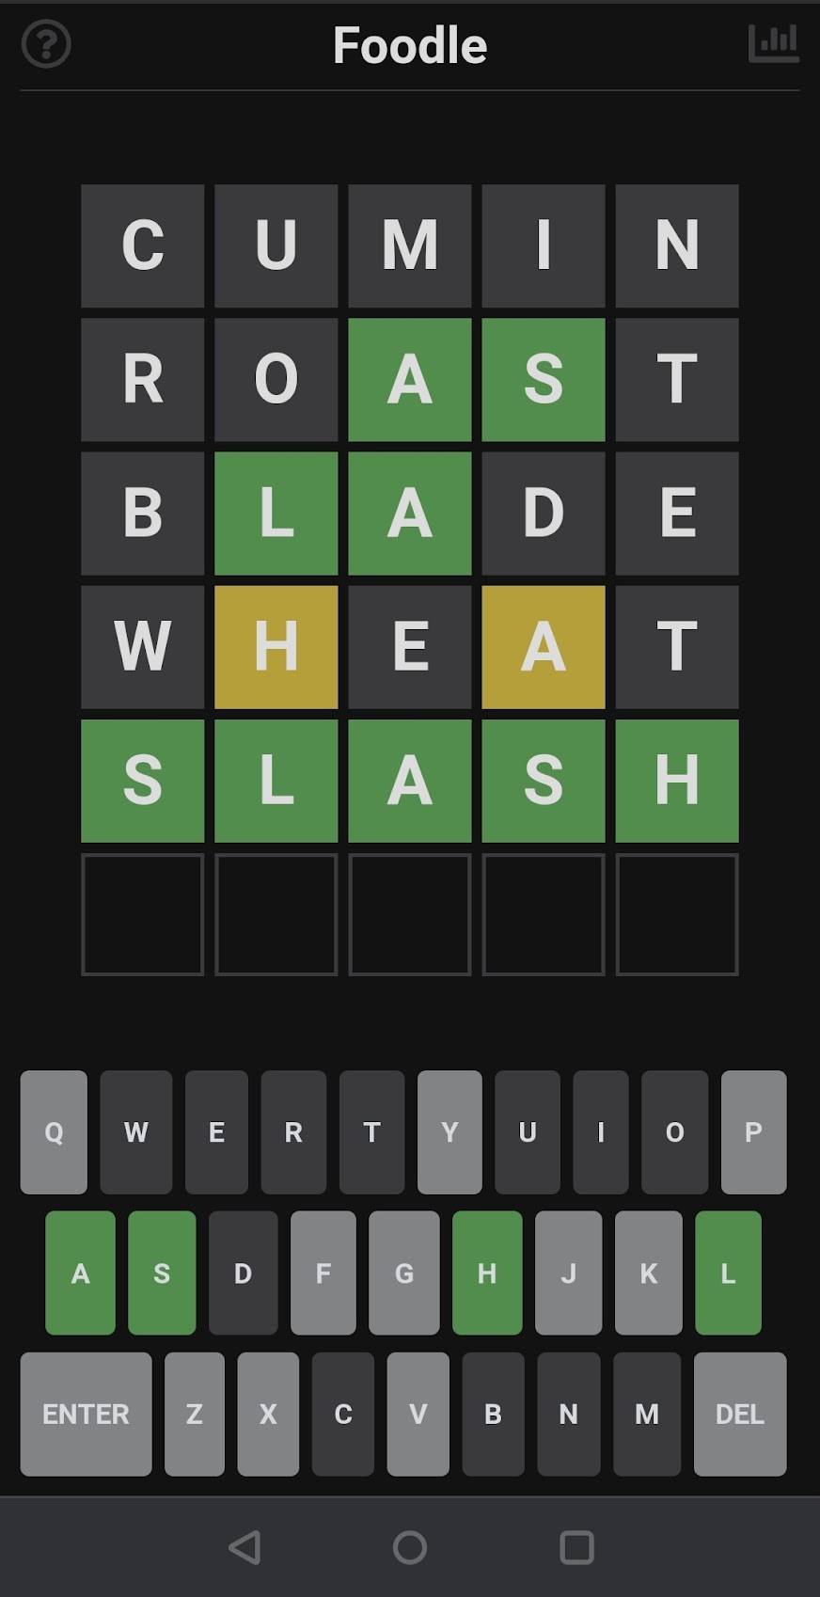

A Culinary Lexicon & Ontology
Nudge: Engaging Word Games
Nutrition, Health, & Sustainability
Foodle, Hangman, A Recipe A Day
Notes:
Gamification of food. Foodle!

Slide 51


Slide 52
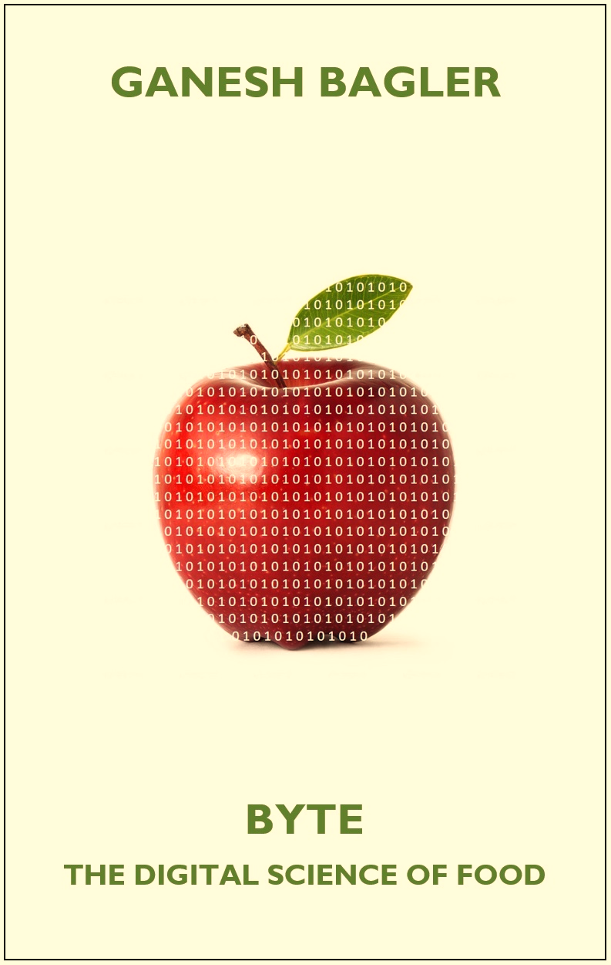
Popular Science
Notes:
Science communication. The adventurous story of computational gastronomy.

Slide 53
Computational Gastronomy
Centre for
Artificial Intelligence
GANESH BAGLER
Making Food Computable
Notes:
Ganesh Bagler. Making Food Computable. Infosys Centre for Artificial Intelligence.

Slide 54
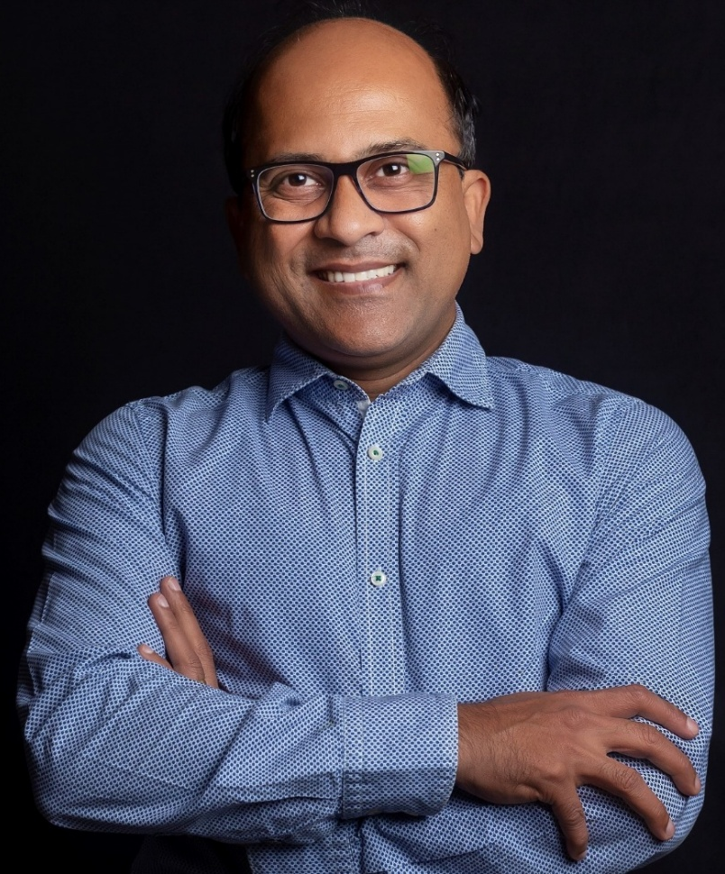
Computational Gastronomy
Ganesh Bagler
Making Food Computable

Slide 55


Slide 56
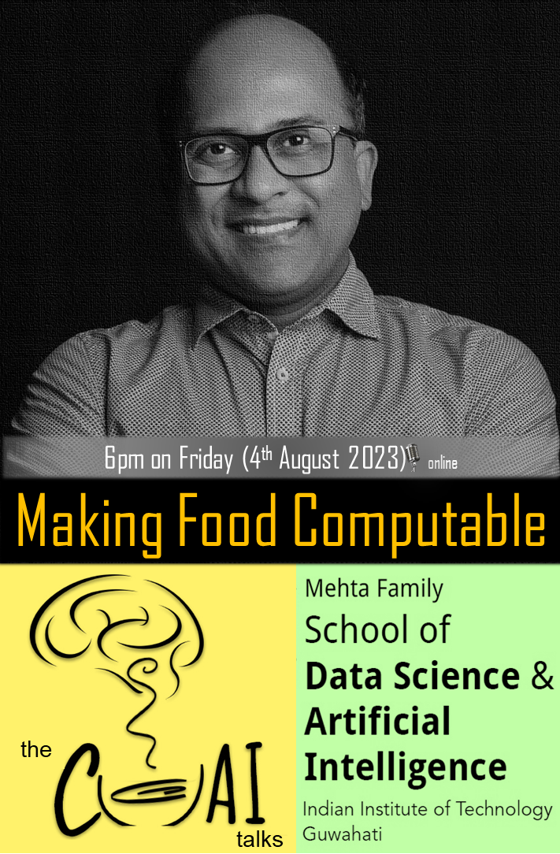

Slide 57
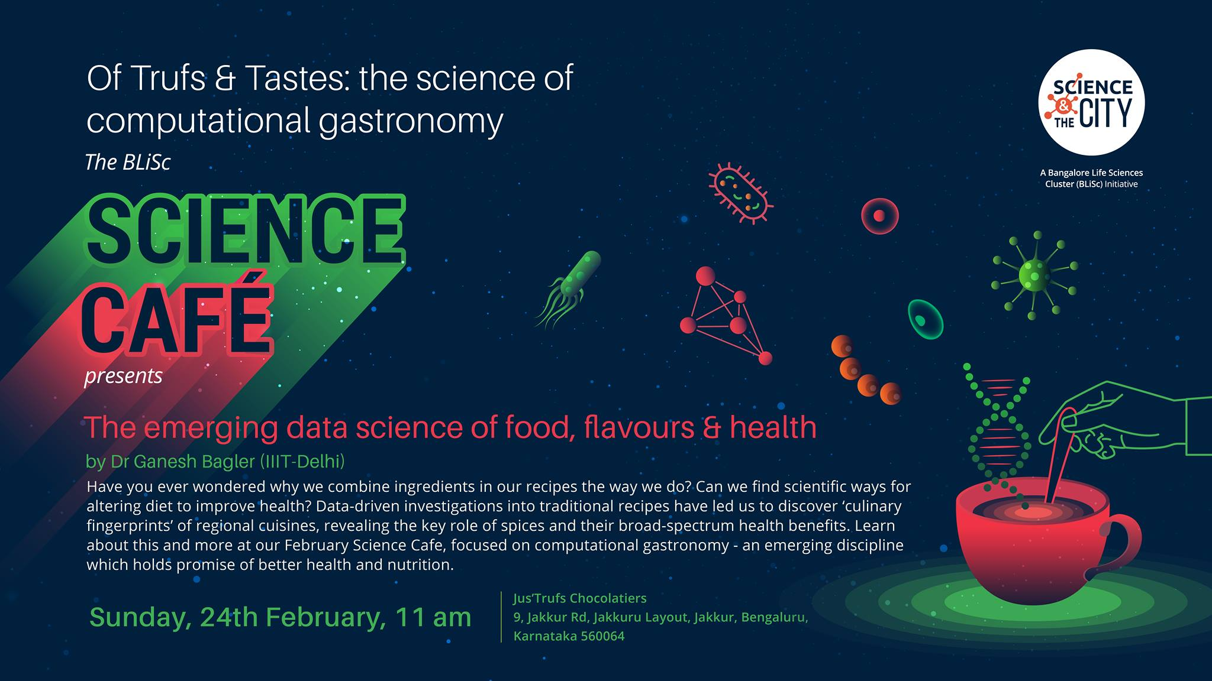

Slide 58
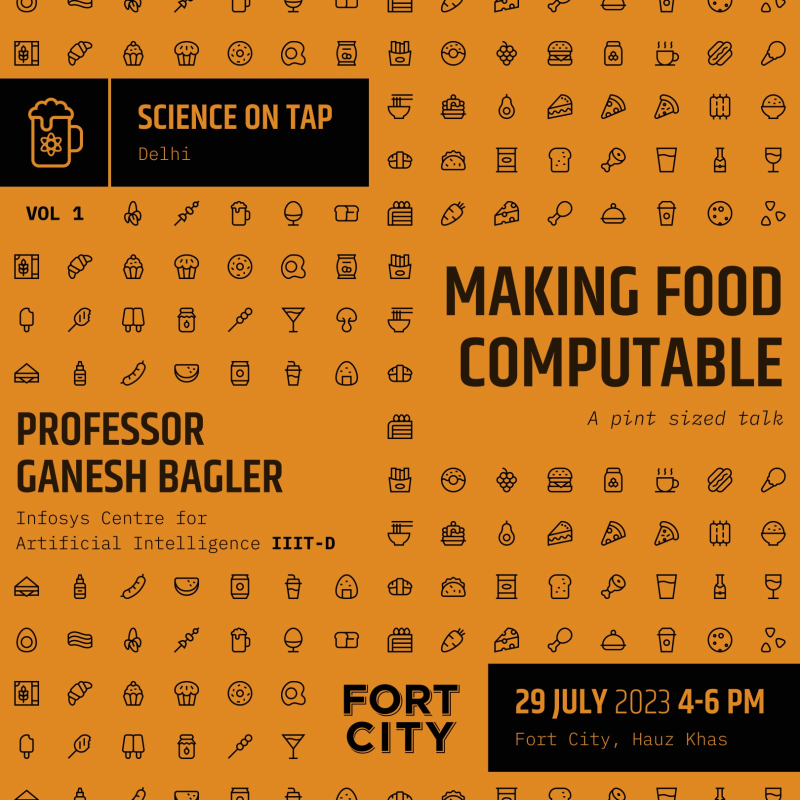

Slide 59


$${10}^{30}$$
Notes:
How many recipes are theoretically possible? How many palatable and tasty food products are possible?

Slide 60

The Foodmaker’s Guide to the Galaxy
Searching the chemical universe for tasty food
Bitter and Sweet Taste Prediction | Scientific Reports (2019)
Sweetness Prediction | Computers in Biology & Medicine (2022)

Slide 61
10th December 2023 (Sunday), IIIT-Delhi
10th December 2023 (Sunday), IIIT-Delhi
Notes:
Symposium on Computational Gastronomy

Slide 62

Next Edition in March 2024, IIIT-Delhi
Notes:
Symposium on Computational Creativity

Slide 63

Computation — Creativity — Artificial Intelligence
Chess—Go
Poetry
Painting
Music
Cooking
Notes:
Computational Creativity

Slide 64


“
The discovery of a new dish confers more happiness on humanity, than the discovery of a new star.
”
Jean Anthelme Brillat-Savarin
Notes:
200 years. Gastronomy – Computational Gastronomy – Discovering stars - Dishes

Slide 65


Slide 66



Complex Systems Laboratory
We are scouting for Ph.D. research scholars, research interns, and project students.
Computer Science | Machine Learning | Natural Language Processing | Deep Learning Computer Vision | Game Design | Android App Development | Entrepreneurship
Notes:
Complex Systems Laboratory: https://cosylab.iiitd.edu.in/

Slide 67

Computational Gastronomy 101
Eat Biryani, Think Biryani, Code Biryani </>
Notes:
Teaching and pedagogy. Building the community of young CSE graduates.

Slide 68

Notes:
Computational Gastronomy MOOC on YouTube.

Slide 69

How sweet is that?
Which dish is that?
Bitter or not?
Sweet or not?
Which cuisine is that?
Notes:
Kaggle Challenges

Slide 70







Slide 71

Computational Gastronomy
“
What was first a lens,
and then a lever,
has now become a vision
for the future of food!
”
Notes:
Food – Quantification – Data Science – Lens – Lever – An engine - A vision to drive the future of food.

Slide 72


Slide 73










Ideation
Teaching
Big Questions
Explore
Applications
Industry
Innovate
Impact
Inspire

Slide 74


Feeding 10 Billion
Notes:
As we stare into the future challenge of FEEDING 10 BILLION by the year 2050, the question is how is food going to change in decades to come? Can we make the food system sustainable for the future generations?

Slide 75




MAKING FOOD COMPUTABLE
JAIPUR
MUMBAI
DELHI
BENGALURU
12—14
July
16—18
July
29
July
1—5
AUG
MAKING FOOD COMPUTABLE

Slide 76

Cuisine Architecture

Slide 77
Computational Gastronomy
Centre for
Artificial Intelligence
GANESH BAGLER
The Future of Food
Notes:
Ganesh Bagler. Making Food Computable. Infosys Centre for Artificial Intelligence.

Slide 78

From astronomy to gastronomy
Dieter Spears | Inhaus Creative
Notes:
Teenager. Aspiring astronomer. Stars. Universe. Enigma. Existential questions.
Why? What? How? … From astronomy to gastronomy

Slide 79







Can a biologist fix a radio?
‘Can a biologist fix a radio?’ Yuri Lazebnik, Cancer Cell (2002)

Slide 80

Can A Computer Think Like a Chef?
Notes:
Can computers think like Chef Gill?

Slide 81

Can A Computer Think Like a Chef?
Notes:
Can computers think like Chef Guglar?

Slide 82
Computational Gastronomy
Ganesh Bagler
Making Food Computable

Slide 83

Infosys Centre for Artificial Intelligence
Indraprastha Institute of Information Technology Delhi

Slide 84


















From astronomy to gastronomy
IHBT
MPIMG
SFI
CCMB
Notes:
Ganesh Bagler. Making Food Computable. Infosys Centre for Artificial Intelligence. Department of Comp. Biology.

Slide 85


Slide 86

Recipes
Flavors
Sustainability
Nutrition
Health
Notes:
From Farm To Fork. Data Compilation, Curation, Analysis, Prediction.

Slide 87
10th December 2023 (Sunday), IIIT-Delhi
Notes:
Symposium on Computational Gastronomy

Slide 88
The Tree of World Cuisines
Bagler*, N Singh, R Tuwani, et. al. (2019) | Jain and Bagler*, Physica A (2019) | Bagler* et al. (2020) | Tuwani, Sahu, and Bagler* (2021)
Notes:
How do cuisine evolve? Defining the identity of a cuisine. How are cuisines related to each other? The hierarchical tree of world cuisines.

Slide 89
Notes:
Building application rooted in data and computation. Real-time dish detection.

Slide 90




Computational Gastronomy
The Future of Food
Ganesh Bagler
Notes:
What an honor it is to present my vision for the data-driven future of food to the top brass of ITC, senior luminaries, and a distinguished audience of 450+ ITC scientists! Congratulations!!

Slide 91

A data-driven strategy for cocktails!
Scattered Knowledge
Structured
Data
Fine-tuned
Model
Generative
Algorithms
Turing Test
Strategy
AI-driven cocktail generator!

